Slide 1
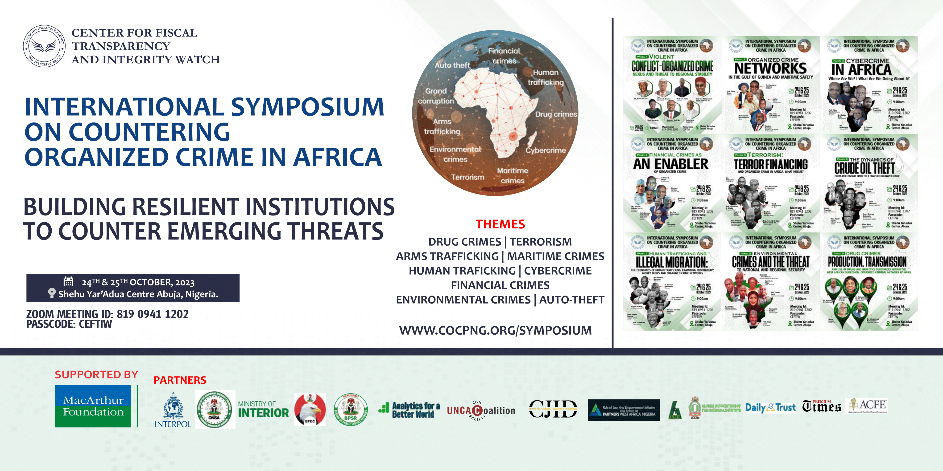

Slide 2
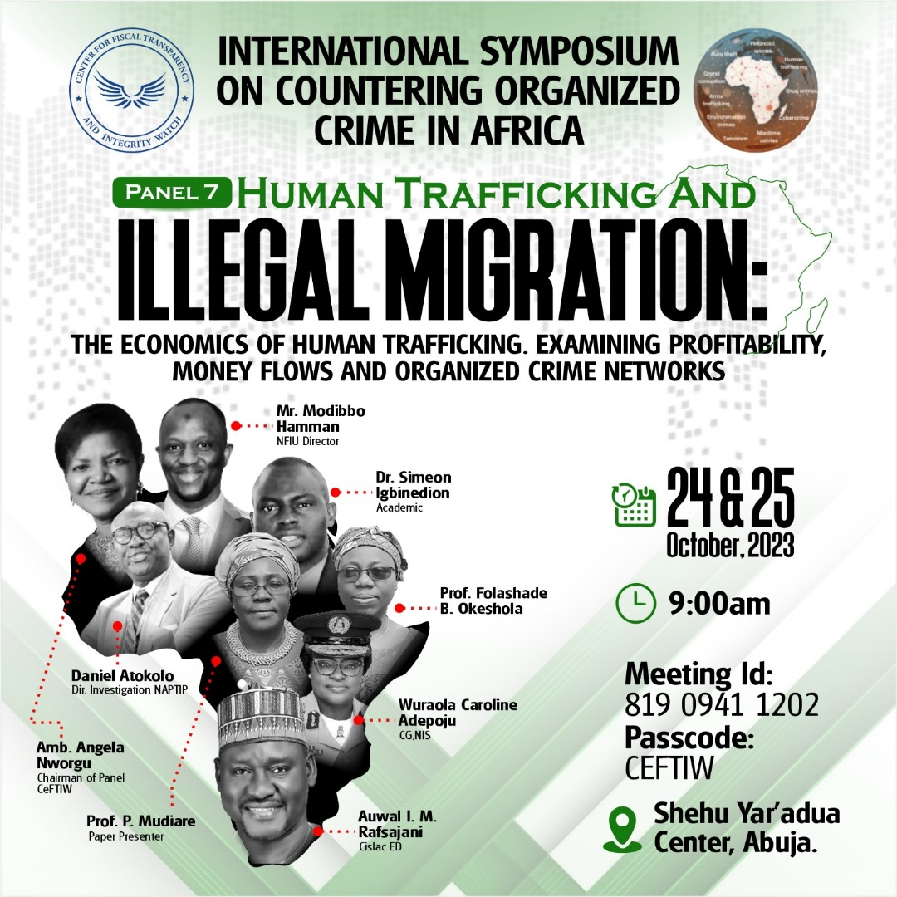

Slide 3
TERRORISM: TERROR FINANCING AND ORGANIZED CRIME IN AFRICA, WHAT NEXUS?
By
Folashade B. Okeshola
Department of Sociology
Ahmadu Bello University, Zaria

Slide 4
Introduction
This paper will examine the concept of terrorism, terrorist, terror financing, nexus between corruption, money laundering and terrorist financing, Government efforts in addressing terrorism and the way forward.

Slide 5
What is Terrorism?
Terrorism is a resort to violence or threat of violence on the part of a group seeking to accomplish a purpose against constituted authority.
Terrorism is a global crime. It is organized crimes engage in by group of people who are not satisfy with the government policies thereby instill fear, threaten the populace, kill and radicalize innocent citizen to belief in their ideology.

Slide 6
Cont…
It is one of the greatest challenges to global peace and security in the 21st century. This act destroys communities, structures and properties. Terrorism has sent many civilian populations around the world- Europe, America, Asia, Middle- East, North Africa and West Africa to their early grave. Properties worth billions of Naira or dollar have been lost or destroyed due to terrorist attacks (Soyombo, 2016).
We can say that despite the efforts put forward to forestall world peace. The world is becoming less secure than some years ago. Many people have been force to alter their life style for fear of terrorism. International trade, tourism and leisure were all affected.

Slide 7
Cont…
Various governments have given their citizens assurances that they are safe and secured.
Terrorism has caused setback to efforts on global peace, security and unity.
At the international level, it has pitched many governments against one another, and at national levels. It has made security agents look clueless, incompetent and ineffective.
According to Nwakanma (2023), no matter the form and manner any violent extreme act is perpetrated, once it contains the elements of ideological persuasion that is intended to change the status quo and influence the government, it becomes an act of terrorism.

Slide 8
Cont…
In view of the above, some organizations have been tag terrorist organizations base on their activities all over the world including Africa and Nigeria in particular.
Such organization includes Alqueda network world wide, Islamic State in Syria (ISIS), Islamic State of Iraq and the levant (ISIL), Islamic State in West African Province (ISWAP) etc.

Slide 9
Types of Terrorism
Nwakanma (2023) identified the following;
National Terrorism: these are activities across national boundaries.
Revolutionary Terrorism: here terrorist activities aimed at changing the philosophy and ideology of government.
Reactionary Terrorism: this form of terrorism is aimed at preventing or matching terrorism with terrorism.

Slide 10
Cont…
Home Grown Terrorism: this type of terrorism is internally generated. Its operations and activities are targeted at the home government, structures and institutions. It is also known as domestic terrorism. Boko Haram in Nigeria can fit into this category. This is a product of dissatisfy Nigerians and their activities targeted at the Nigerian state.
Cross – Border Terrorism: this is international terrorism whose activities go beyond one country. This type poses a great threat all over the world. They operate across borders, they are committed, adopt different methods and also finance other terrorist organizations.

Slide 11
Motives
All terrorists have motives be it international or domestic. A terrorist group commits acts of violence to:
Produce widespread fear;
Obtain worldwide , national, local recognition to their cause by attracting the attention of media;
Harass, weaken, or embarrass government security forces, so that the government over- reacts and appear repressive;
Steal or extort money and equipment, especially weapons and ammunition vital to the operation of their group;
Destroy facilities or disrupt lines of communication in order to create doubt that the government can provide for and protect its citizens;

Slide 12
Cont…
Discourage foreign investments, tourism, or assistance programmes that can affect the target country’s economy and support of the government in power as it is currently happening in Niger Delta;
Influence government decisions, legislation or their critical decisions;
To free prisoners, just as we have cases of jail break in Nigeria in recent time.

Slide 13
Who is a Terrorist?
A terrorist is the person who engages in the act of terrorism. There are two
categories of terrorism. These are international terrorism and domestic
terrorism. International terrorists operate across countries. They move from
one country to another. Domestic terrorists operate within a country.
Terrorist be it as an individual or as a group provides a set of beliefs about the external world that foster an identity around a commitment to a course.
There are different types of terrorists with different names. Terrorists see their role as one of martyr who are ready to sacrifice their lives.

Slide 14
Cont…
Some perceive terrorists to be suffering from psychological condition known as antisocial personality disorder or psychopathic personality disorder. Terrorists lack empathy for the suffering of others. Most terrorists are above-average intelligence and have sophisticated ethical and moral development (Crenshaw, 2000; Slke,2003).
There are three types of domestic terrorists. These are right- wing terrorists, left-
wing terrorists and special - interest groups.. Terrorists operate under different names to achieve their motives. The tactics adopted include bombing, hijacking, suicide bombing, cyber terrorism etc.

Slide 15
Right - Wing Terrorists
This group adheres to the principles or racial supremacy and embraces
anti-government, and regulatory beliefs. They believe that inevitably there
will be a “showdown” with the Federal Government, so they pile up
weapons and food to sustain them (Wilson,2002).

Slide 16
Left - Wing Terrorists
They adhere to a revolutionary socialist doctrine and view themselves as protectors of the people against the “dehumanising effects” of capitalism and imperialism. They advocate revolution as a means of transforming society. This can be seen in the case of Boko Haram saga in Borno State(Nigeria) in 2009.

Slide 17
Special - Interest Groups
Both are destructive of property but uphold a philosophy that discourages harm to “any animal, human or non human”.
The activities of ethnic militias and Islamic extremists are issues today in Nigeria that resembles terrorism. Their style of attacks, which includes vandalization of the nation’s important establishments, kidnapping and even bombings have similar characteristics with the other world terrorist groups.

Slide 18
Tactics Used by Terrorists
Terrorists have a wide range of tactics available to them. These include using various types of bombs or impoverished explosive devices (IEDs), skyjacking planes, hijacking vehicles carrying hazardous materials, taking hostages, kidnapping and engaging in assassination, ambushes ( in which many of our security personnel have fallen victims), harassment raids and sabotage (Watson, 2002).

Slide 19
Cont…
Bombing: Bombing is the most common type of terrorist act. Typically impoverished explosive devices are inexpensive and easy to make. Modern devices are smaller and are harder to detect. They contain very destructive capabilities e.g. September 11, 2001 attack claimed so many lives of innocent American citizens, Mandala bombing in Niger State, United Nations building at Abuja, bombing of hotel in Kenya.

Slide 20
Cont…
Kidnapping and Hostage Takings: Terrorists use kidnapping and hostage taking to establish a bargaining position and to elicit publicity. Kidnapping is one of the most difficult acts for a terrorist group to accomplish, but, if a kidnapping is successful, they can make a lot of money. Terrorists also bargain for the release of jailed comrades and their publicity can remain for a long period. Hostage taking involves the seizure of a facility or location and the taking of hostages.

Slide 21
Cont…
Hijacking and Skyjacking: Hijacking is the seizure by force of a surface vehicle, its passengers and or its cargo. Skyjacking is the taking of an aircraft, which creates a mobile, hostage barricade situation. It provides terrorists with hostages from many nations and draws heavy media attention. Skyjacking also provide mobility for the terrorists to relocate the aircraft to a country that supports their cause and provides them with a human shield making retaliation difficult (Terror Watch Web, 2006).

Slide 22
Cont…
Nigerians experienced this situation during late Chief Ernest Shonekan’s Interim Government in 1993, when a passenger plane was diverted and could not be located for some hours. This strategy was just to press the hijackers’ points that they were not happy with the government of the day.
Cyber Terrorism: Is a new form of terrorism that is on the increase. It provides terrorists opportunity to disrupt or destroy networks and computers. The result is interruption of key government or business- related activities.

Slide 23
What is Terrorist Financing?
Terrorist financing is the provision or collection of funds with the intention to be used to carry out acts that support terrorist or terrorist organizations.
According to GIABA (2022), terrorist financing refers to the financing of terrorist acts. It may be individual terrorist or terrorist organizations. It can involve funds raised from legitimate sources, such as personal donations and profits from businesses and charities as well as criminal sources such as drug trafficking, smuggling of weapons and other goods, fraud, abduction and extortion.

Slide 24
Cont…
Terrorist financing is a process of collecting, transmitting and distributing funds for their activities. It includes the financing or aiding, abetting and facilitating of terrorist acts and terrorist organizations. It is a collection of funds by any means directly or indirectly, intending to be used in full or in part to carry out terrorist activities (Counter-Terrorist Financing, 2023)
The United Nations Office on Drug and Crime (UNODC) is of the view that terrorist financing involves the solicitation, collection or provision of funds with the intention that they may be used to support terrorist acts. This is because terrorists need money to recruit, support members, maintain logistics, hubs and conduct operations.

Slide 25
Cont…
Terrorists use proceeds from drug trafficking, kidnapping, weapon trafficking etc.to finance their activities. Source of terrorist funding are diverse. Some of them include kidnapping for ransom, the misuse of non-profit organizations, and the illicit trade in commodities (such as oil, diamond, gold and the narcotic).

Slide 26
Motives
One of the motives behind terrorist financing is ideological rather than profit – seeking, which is generally the motivation of most crimes associated with money laundering.
The purpose of terrorist financing is not to hide illegal money but to suppress a population or state through violence and coercion and raise funds to finance criminal acts.
Some major reasons fueling terrorism in Africa is induced by religious or economic considerations. While some terrorists involve in terrorism as a divine act, others see it as a means of transforming their economic conditions.

Slide 27
Cont…
Terrorist could be seen differently depending on where you are looking at it from. This is why the motive for terrorism is ether rightist, leftist or people-centered. This is responsible for the popular saying that “one person’s terrorist is another’s freedom fighter”.

Slide 28
Sources of Terror Financing
Terrorists use different sources to finance their terrorist activities.
The fund may come from legitimate and illegitimate sources. The legitimate sources of terrorist financing include money from wealthy benefactors, organizations or business activities. Illegal sources include money realize from drug trafficking, extortion, armed deals and trafficking. The activities are carried out discretely to avoid drawing the attention of the law enforcement. Funds receive are laundered through the financial system so as to conceal the origin and destination.

Slide 29
Cont…
Also, money received an be laundered and distribute through terror cells, which is in turn use to purchase weapons, pay for supplies and logistics so as to advance the group’s goals (Kagan, 2021).
The process of terrorist financing can be seen from four different stages. This includes the process of collecting, storing, moving and using the funds.

Slide 30
Nexus between Terror Financing and Organized Crime
Terrorism, corruption, money laundering and terrorist financing all fall under the concept of organized crime. It strives through networking. It is like a web, a chain of activities with each person expected to carry out specific task within the group. Therefore, there is the link or relationship between corruption, money laundering and terrorist financing.

Slide 31
Corruption and Terror Financing
Corruption serves as a catalyst for many criminal activities including terrorism and it’s financing. Corruption hinders the promotion of transparency, the security of the people and their property.
Corruption is widespread in Nigeria not because the people are different from people from other parts of the world, but because the conditions are ripe for it. There are many reasons why this is so. One, the motivation to earn income from among the populace is relatively stronger. Two, increase in poverty level among the populace, low wages and high rate of unemployment all encourages this act (Okeshola, 2009).

Slide 32
Cont…
-In Nigeria, accountability is generally weak, political competitions and civil liberties are often restricted. Laws and principles of ethics in government are poorly developed and the legal institutions charged with enforcing them are ill- prepared.
The impediment to implementation of Anti - Money Laundering standards include Anti - graft Agencies been manned by corrupt personnel, pressure of organized crimes forces on enforcement officials, harassment of political opponents by law enforcement agencies, lack of cooperation by banks and other financial institutions in performing what is required by law, perceived high susceptibility of returned loot to corruption/ laundering all over again (Okeshola, 2012).

Slide 33
Cont…
-Corruption techniques are largely determined by the prevailing forms of corruption trends. There are various forms and manifestations of corruption both in the public and private sectors. Forms of corruption vary. Corruption may facilitate criminal enterprise such as drug trafficking, money laundering, weapon smuggling and human trafficking,

Slide 34
Money Laundering and Terrorist Financing
-Money Laundering is the processing of assets from criminal activity to cover their illegal origins. Terrorists raises money to support terrorist activities.
-Terrorists use money laundering techniques to avoid detection by authorities and to protect the identities of their sponsors and the beneficiaries of the funds. Terrorist financing can be linked to money laundering if criminal proceeds are use to fund terrorist activities.

Slide 35
Similarities
-Both money laundering and terror financing involve the use of networks to hide or conceal the origin of funds.
-Their activities can destabilize the economy of any country be it in Nigeria or Africa as a continent.
- This act of money laundering and terror financing can lead to compromising the integrity of financial institution as many of the stolen monies are laundered in the bank or via bureau de change. This enables them to finance terrorist activities.

Slide 36
Cont…
- Money laundering and terror financing occur throughout the world and this is a threats to peace and security.
-Both money laundering and terror financing divert resources away from economically and socially productive uses and this has negative effect on the country’s financial institutions.
-There are similarities in the way money are move. There are three stages in terror financing. It involves the raising of funds, moving and using the funds.

Slide 37
Differences
The main difference between money laundering and terrorism financing is the origin of the funds.
Financing terrorism has to do with the collection of capital to carry out terrorist activities.
Money laundering is a process used by a criminal to hide his or her illicit funds to appear legal.

Slide 38
Efforts to Curb Terror Financing
Nigeria’s legal system has been strengthened with the enactment of the Terrorism (Prevention and Prohibition) Act, 2022(TPPA). Terrorism-financing offences to include financing of terrorist acts, financing of a terrorist organization for any purpose, financing of an individual terrorist for any purpose.

Slide 39
Agencies saddled with the responsibility should be up and doing. They should be disciplined and professional in their conduct (ICPC, EFCC, INTERPOL, NDLEA, SSS etc.)
Most importantly, rivalry among Law Enforcement Agencies should be curtailed so as to achieve the set objectives.

Slide 40
Recommendations
Nigeria should engage in information exchange with other countries, such as alignment with INTERPOL, which I believe is on- going.
-To engage in bilateral relations with sub- regional organizations such as the International Chiefs of Police Association (ICPA) to get legal assistance in criminal matters and extradition.

Slide 41
Cont…..
Policing the sea is a good measure to reduce sabotage of the oil sector ,which is the main source of revenue in Nigeria.
To counter the financing of terrorism, there is need to block the free flow of funds to the terrorists. Without funding, they cannot purchase weapons, equipment and supplies.

Slide 42
Cont…
There is need for proper re -orientation of Nigerians to shun violence and to embrace dialogue in solving teething problems.
On the whole, it is necessary to shift from practice to result.
There is need for improvement in the socio- economic life of the people and leadership should be by example.
.

Slide 43
Cont…
Punitive measures on corrupt practices and value re -orientation among the populace should be encouraged.
Independence of Law Enforcement agencies that are concern with Anti -Money Laundering will go a long way in curbing terrorism and terror financing in Nigeria and Africa in general.

Slide 44
THANK YOU FOR LISTENING .

