Slide 1
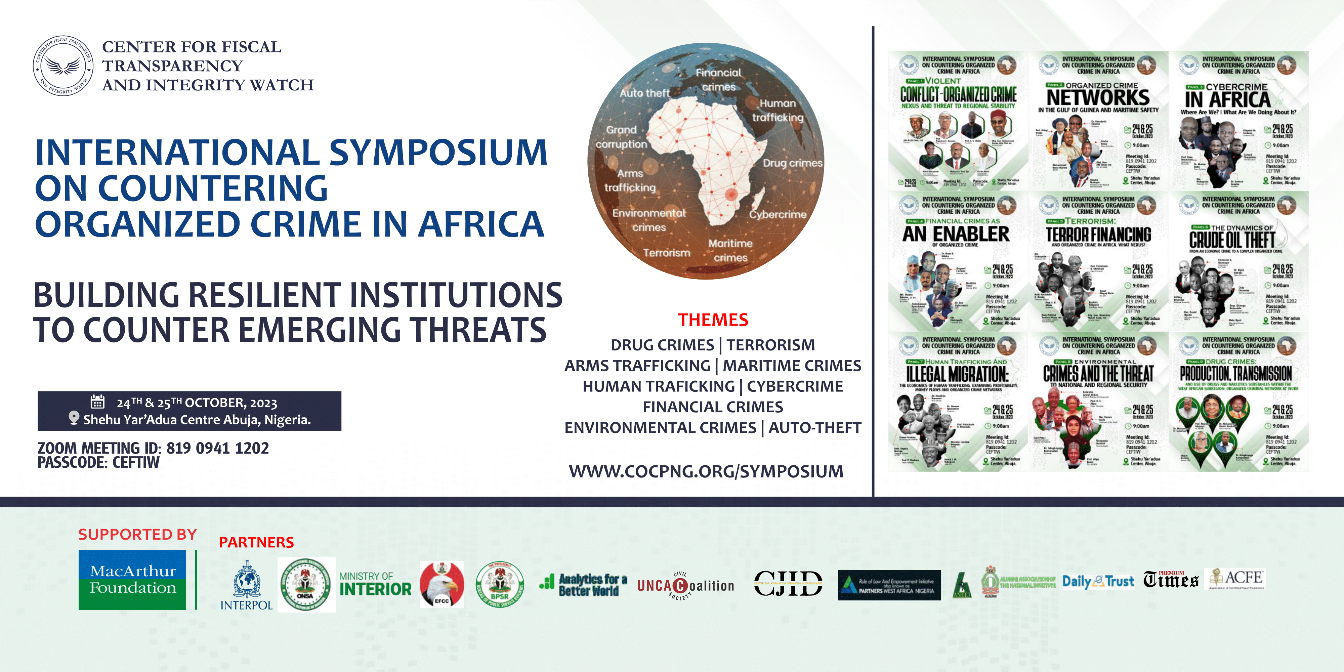

Slide 2
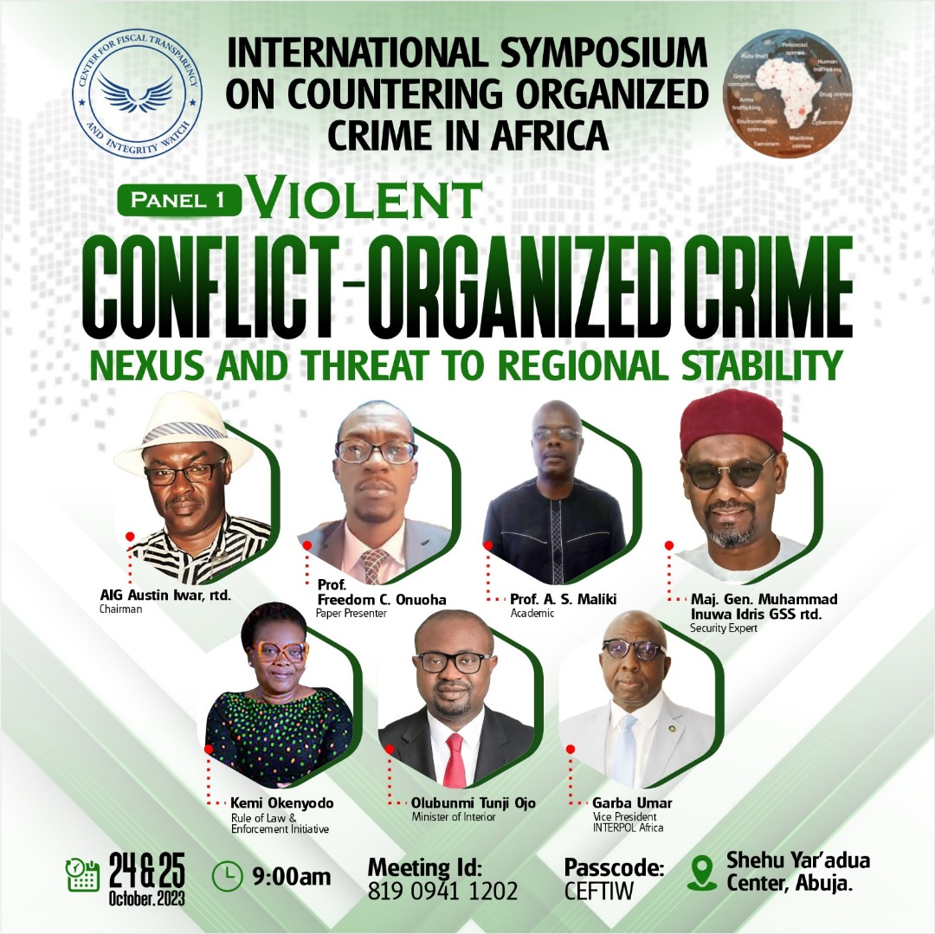

Slide 3
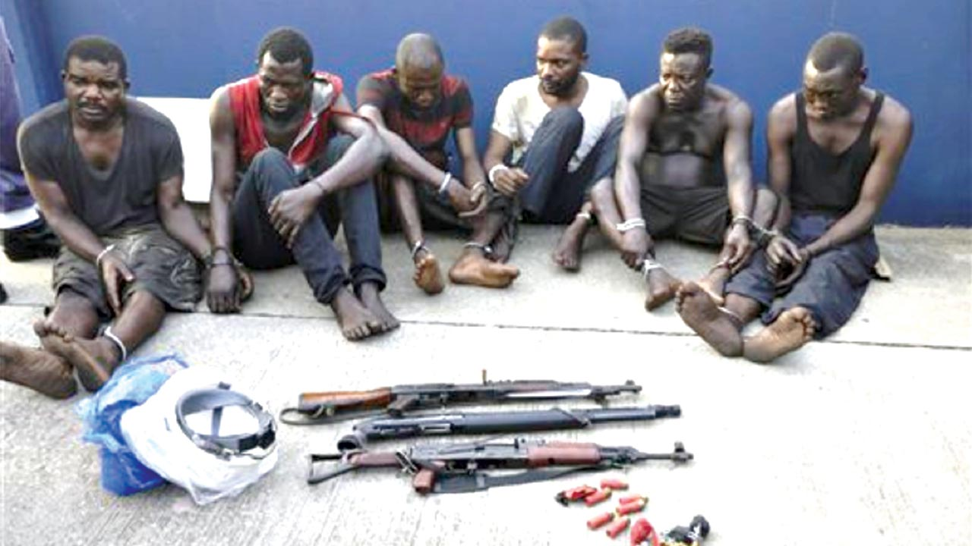
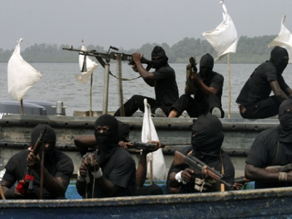
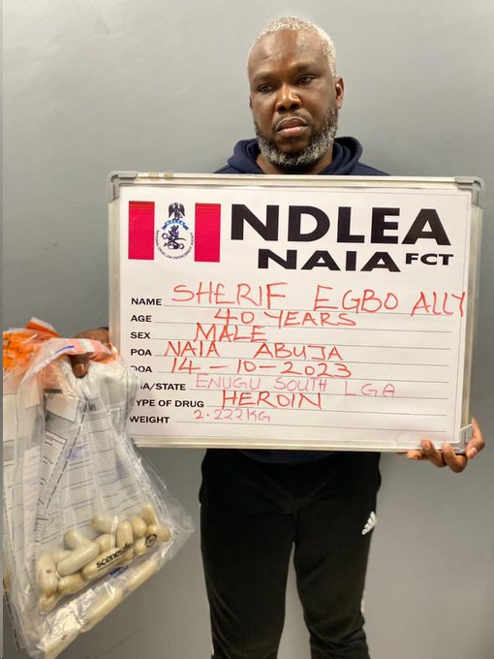
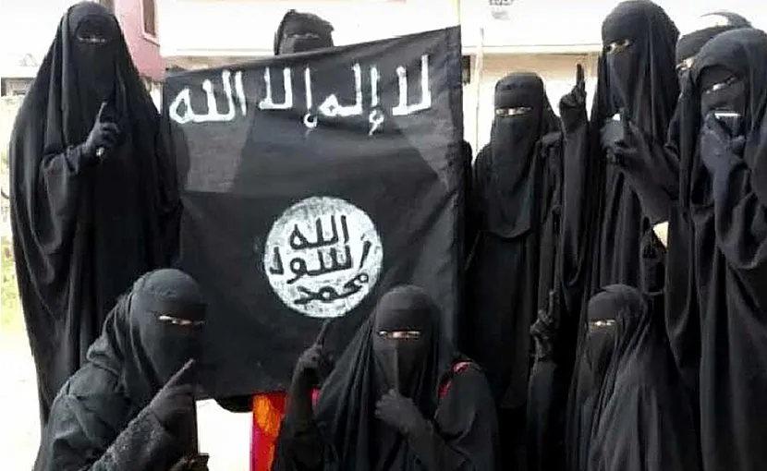
VIOLENT CONFLICT-ORGANIZED CRIME NEXUS AND THREAT TO REGIONAL STABILITY
Prof. Freedom C. Onuoha
University of Nigeria nsukka
1st International Symposium on Countering Organized Crime in Africa
24 October 2023

Slide 4
Introduction
The nexus between violent conflict and organized crime and the threat they pose to peace, security and development is not new
A 2022 study revealed that Africa is the region with the largest absolute number of fatalities from one-sided violence. This type of violence is perpetrated mainly by non-state actors
A 2021 study found that 40% of UNSCRs passed in 2018 demanded a response to organized crime in conflict settings, rising to 50% in 2019.
The impact of their manifestation and connexion have been particularly acute and destabilising in Africa
Organised crime is one of Africa’s biggest security challenges - Annual loss of US$88.6 billion in illicit financial flows linked to criminal activities
Across Sub-Saharan Africa (SSA), the damaging impact of violent conflicts and organised crime is felt by individuals, communities, and states

Slide 5
Aim
The nature and nexus of violent conflict and organised crimes in Sub-Saharan Africa to reveal how they undermine regional stability
Frame the violent conflict-organized crime nexus
Geography and trend of violent conflict in SSA
Forms and prevalence of organized crime in SSA
Impact of violent conflict-organized crime nexus in SSA

Slide 6
Scope of Presentation
1
Introduction
2
Key Concepts and Definitions
3
Epistemic Context of Violent Conflict-Organised Crime Nexus
4
Geography of Violent Conflict in Africa
5
Forms and Prevalence of Organized Crime in Africa
Impact of Violent Conflict-Organised Crime Nexus in Africa
6
7
Recommendations for Curbing Conflict-Organised Crime Nexus in Africa

Slide 7
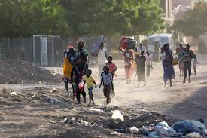
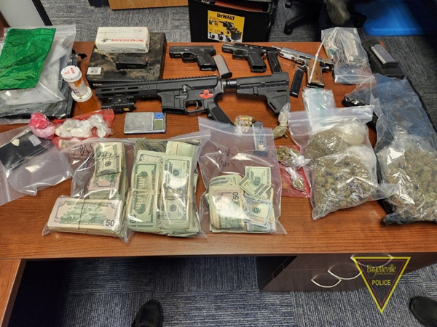
Working Definition of Terms
Violent Conflict
Struggle over values or claims to status, power, and resources, in which the aims of the opposing parties are not only to gain the desired values, but also to neutralize, injure or eliminate their rivals using physical or lethal force
Organised Crime
Illegal activities, conducted by groups or networks acting in concert, by engaging in violence, corruption or related activities in order to obtain, directly or indirectly, a financial or material benefit. Such activities may be carried out both within a country and transnationally
enact, 2021:11

Slide 8
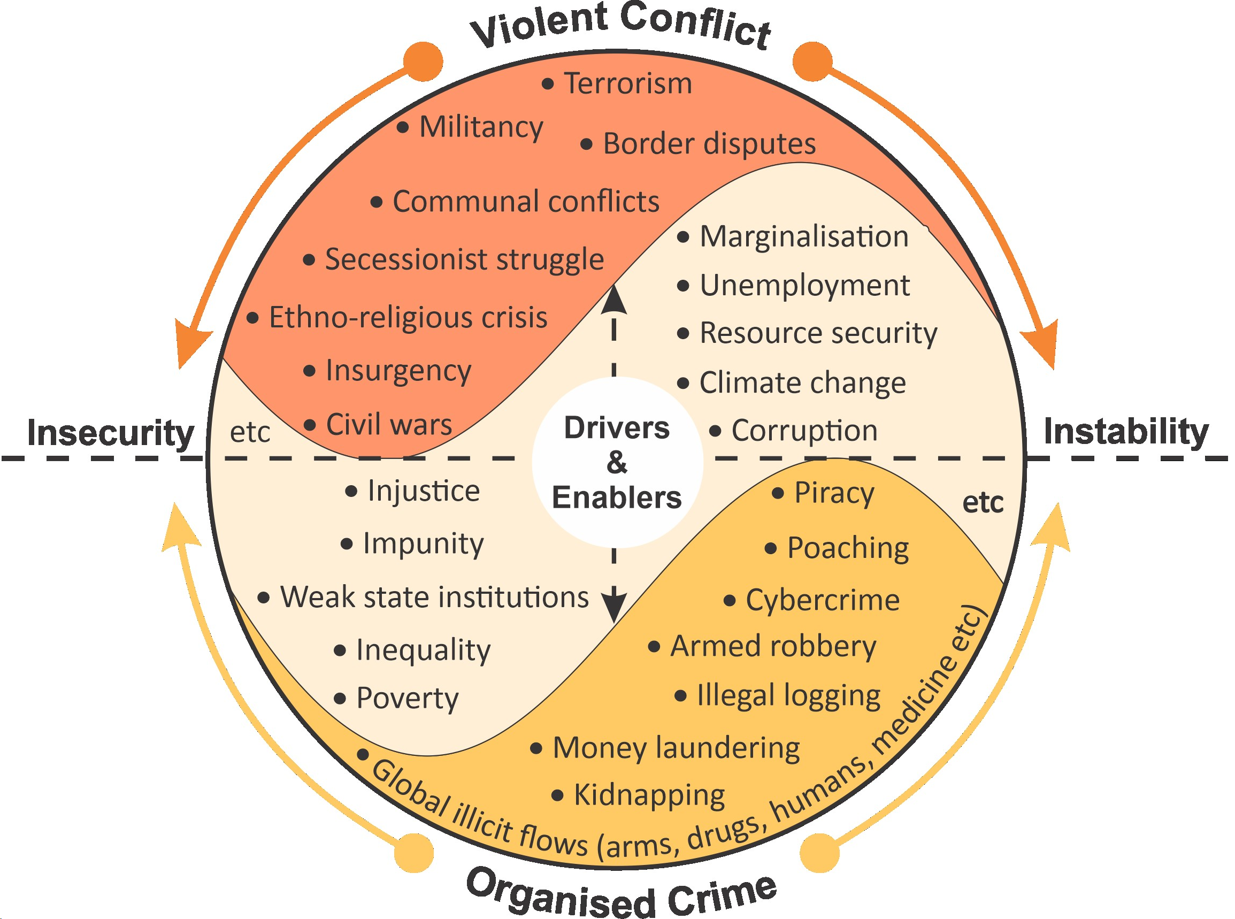
Epistemic Context and Framing
Mapping the Violent Conflict-Organised Crimes Nexus

Slide 9
Epistemic Context and Framing
Violent Conflict-Organised Crimes Dynamics
The outbreak of conflict creates opportunities for organised crime groups to emerge and/or thrive
In turn, organised crimes seek out opportunities in conflict situation to profit from crisis and chaos
Insecurity and instability are conditions conducive and propitious to the rise and reign of organised crime, often becoming key sources of revenue for non-state armed actors and state actors alike
To varying degrees, conflict economy and criminal economy overlap or reinforce each other – they are both dynamic and constantly intersecting and interacting to foster the persistence of insecurity and instability
Instability and insecurity benefit conflict and criminal entrepreneurs (States and non-state actors alike)

Slide 10
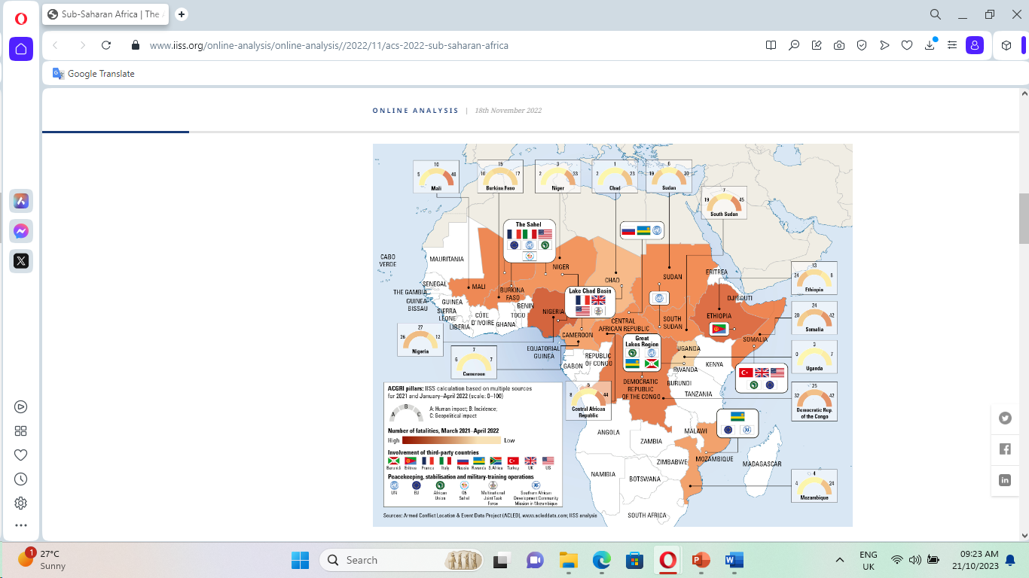
Geography of Violent Conflicts in Africa
Concerning Trends
Armed Conflict Survey of Africa, focus on SSA 2022
Africa remains the region with the most state-based conflicts per year in 2022 (26 cases).
Compared to ten years ago, the number of conflicts in Africa has nearly doubled, from 15 in 2013 to 26 in 2022
Internationalisation of internal armed conflicts/geopolitical competition
Continued resource pillage of resources – foreign states and actors as organized criminal syndicate
Expanding and escalating violence by non-state actors (violent extremism & terrorist groups)
International Institute for Strategic Studies (2022)

Slide 11
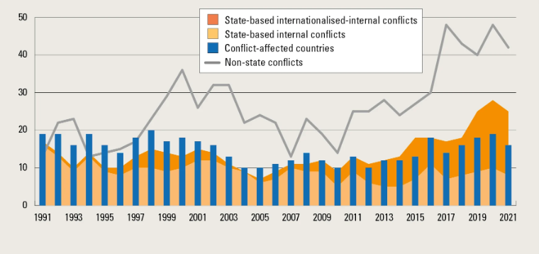
Geography of Violent Conflicts in Africa
Nature and Trend of Violent Conflict in Sub-Saharan Africa, 1991-2022
International Institute for Strategic Studies (2022)
During the reporting period, there was explosive rise in the number of non-state armed conflicts in sub-Saharan Africa (SSA)
In SSA, Mali recorded the largest deterioration with conflict-related deaths increasing by 154%, while violence against civilians rose by 570% (2023 Global Peace Index report)

Slide 12
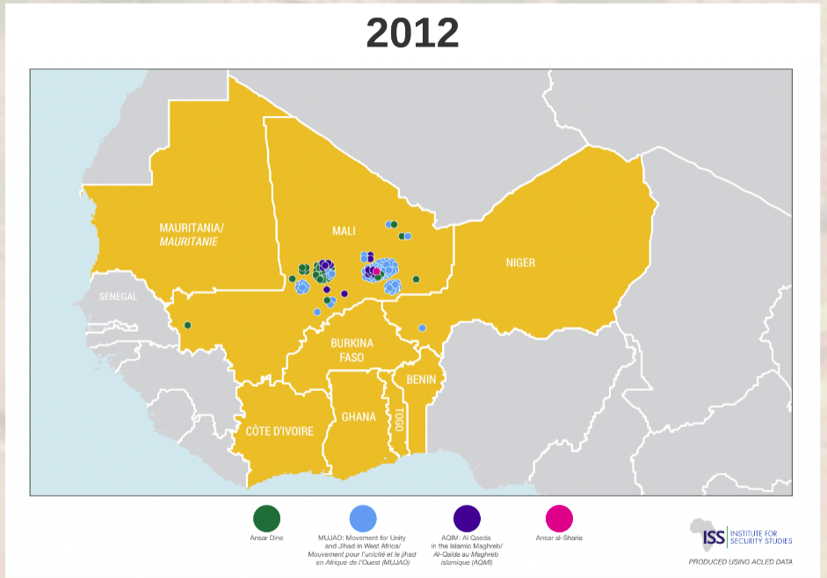
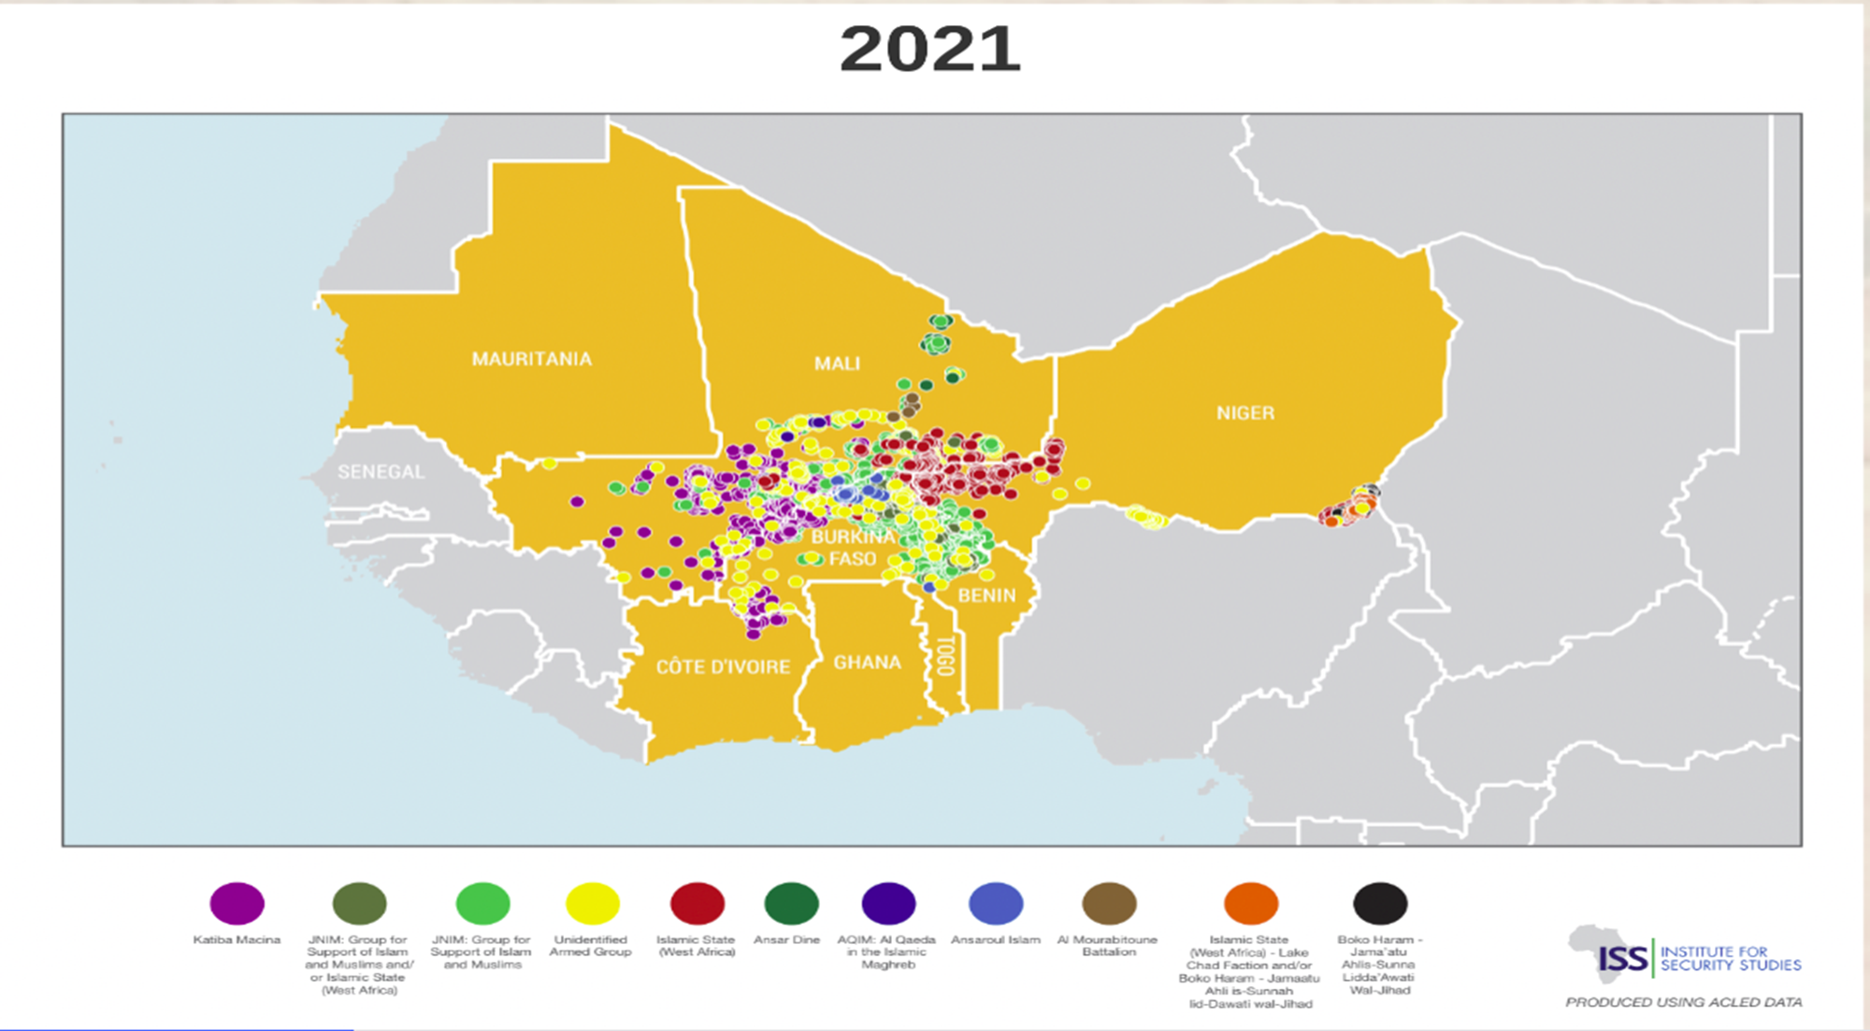
Geography of Violent Conflicts in Africa
Insights from the Sahel Case Study, 2012-2021
2012
2017
2021

Slide 13
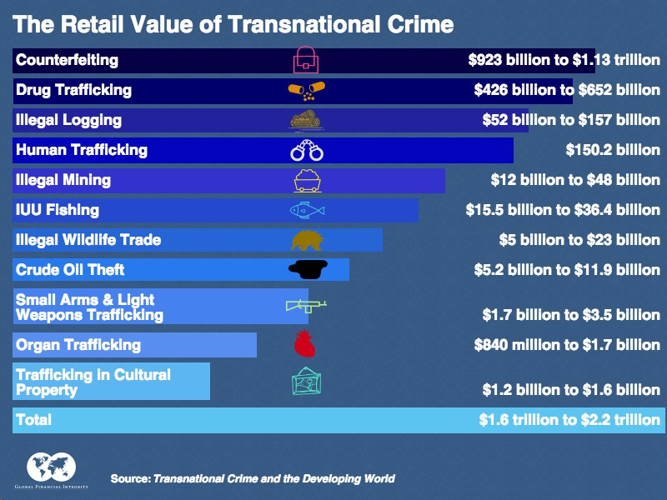
Growing Threat of Organised Crime
Global Financial Integrity, Transnational Crime and the Developing World, (2017)

Slide 14
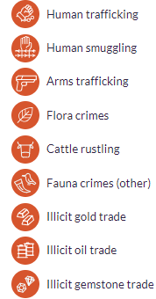
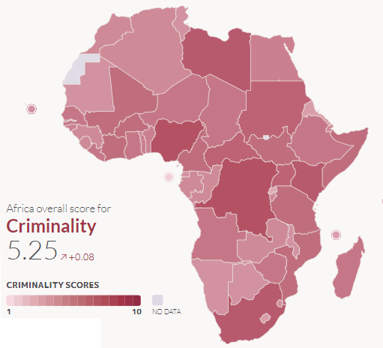
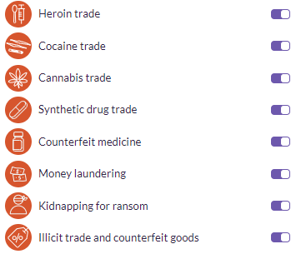
Major Organised Crimes in Africa
Africa continued to experience high levels of criminality since 2021, remaining the second highest scoring continent in the world after Asia (Global Organized Crime Index, 2023)
Global Organized Crime Index 2023

Slide 15
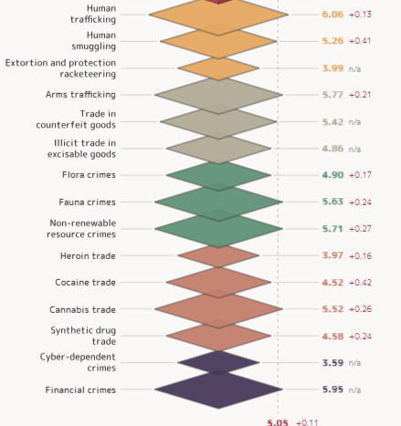
Major Organised Crimes in Africa
Global Organized Crime Index 2023: Highlights on Africa
The most pervasive criminal market in Africa is human trafficking
Levels of environmental crime continued to increase on the continent
Criminal networks and foreign actors also have a strong grip on the continent
State-embedded actors remained the most dominant agents behind illicit economies
The prevalence of this criminal economies is correlated to various factors, including the numerous ongoing conflicts in Africa
Global Organized Crime Index 2023

Slide 16
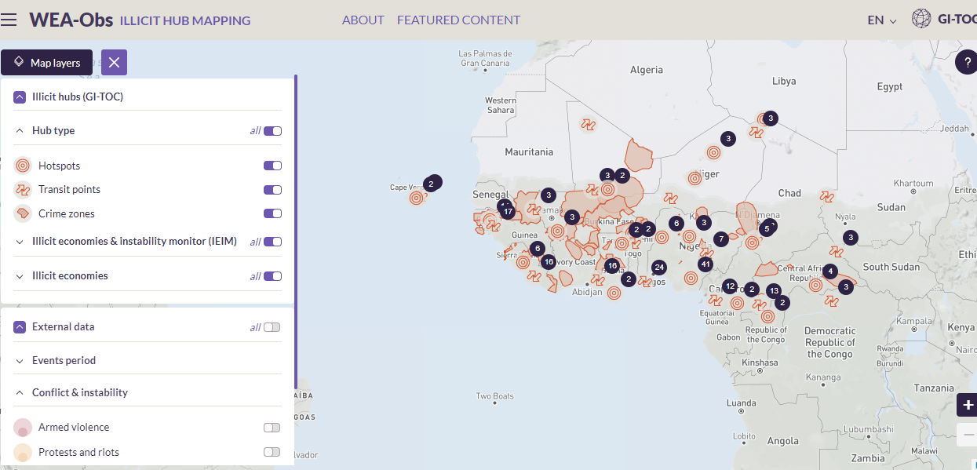
Major Organised Crimes in Africa
Mapping of Illicit Hubs or Economies in West Africa
https://wea.globalinitiative.net/illicit-hub-mapping/map

Slide 17
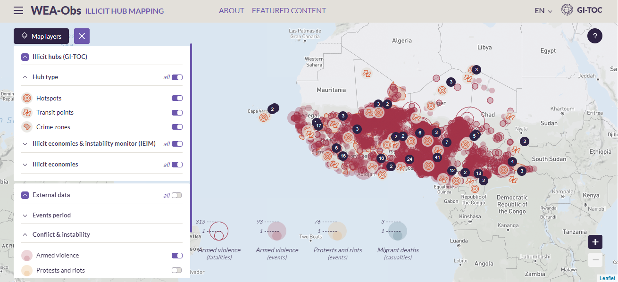
Major Organised Crimes in Africa
Overlay of Illicit Economies and Armed Violence in West Africa
https://wea.globalinitiative.net/illicit-hub-mapping/map

Slide 18


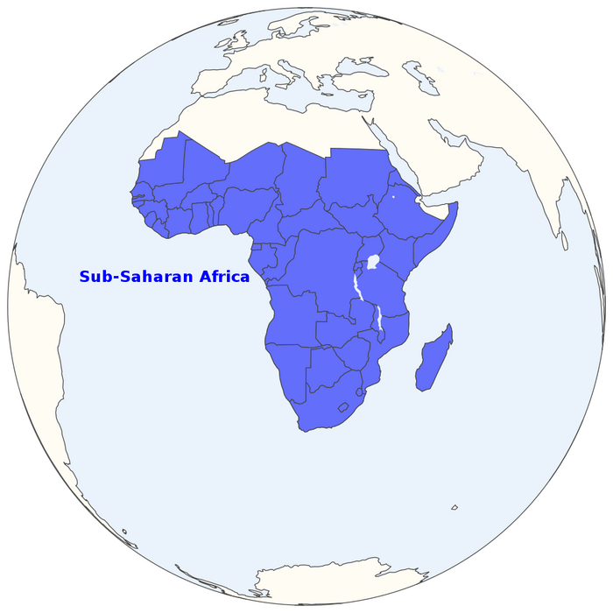
Sub Saharan Africa’s Vulnerability to Violent Conflict and Organised Crime
Complicity of the political elites: Elites often become rich due to their connections with an array of illicit actors, including traffickers, smugglers, corrupt fixers, and brokers
Weak rule of law: When the law is not applied evenly, and transparency and accountability mechanisms are weak, state officials collude with criminal networks
01
06
Persistent state fragility: In much of SSA, the state is no longer fulfilling its core responsibility of providing important public goods, allowing non-state actors to fill the void
Border porosity: Sates’ borders are generally known to be porous and fragile, thereby promoting transnational criminal flows rather than facilitating integration in the region
02
05
05
Drivers & Enablers
03
04
Economic Marginalisation: The World Bank estimates that eight of the world’s top 10 countries with the greatest rates of inequality are African
Limited policing capacity: Africa has far fewer police per citizen than other regions. There are only 180 police per 100,000 people on the continent, compounded by lopsided elitist deployment

Slide 19
Exacerbate the threat of violent extremism: The most visible impact of the violent conflict-organised crime nexus is the rise in violent extremism and terrorism. Criminal networks and activities fuel violent conflict and finance terrorists
Create serious economic distortions: The UNCTAD estimated in 2020 that Africa lost about US$88.6 billion in illicit financial flows linked to criminal activities. This is equivalent to 3.7% of the continent’s GDP. The loss of money through these crimes is a serious issue for regional stability
Compromise national security: When they penetrate state institutions, organized crime undermines national security by corrupting state security forces, with dire implications for public safety. The case of Guinea-Bissau as narco-state: Feb 2022 attempted coup
Diffusion or spillover of risks: Conflict –crime dynamics generates spill over risks. Following the ousting of Muammar Gaddafi in 2011, southward arms flows from Libya enabled armed groups operating in the Sahel and Lake Chad Basin, leading to destabilization of the Liptarko-Gourma region and Lake Chad region
Complexification of threat environment: The dynamics of organized crime in cocoa industry help drive deforestation in Côte d’Ivoire by allowing loggers and timber traders to illegally remove trees from protected areas to make way for cocoa crop.
Impact of Conflict-Crime Nexus on Political Stability in SSA

Slide 20
Recommendations
1
Leverage platforms for scholar-practitioner dialogues
There is the need for supporting empirical research to generate context-specific clarity on violent conflict-organised crime nexus from a convergence lens to inform policy & programmatic responses
2
Prioritize strategic dialogue to resolve conflict
De-emphasizing militarized response and prioritizing strategic dialogue to resolving the deeper drivers of intergroup conflict
Responding to violent conflict-organised crime dynamics in Africa
3
Strengthen inter-agency collaboration
Provide an opportunity for various state actors to work together and draw on their combined resources to effectively investigate and prosecution conflict and criminal entrepreneur
Invest and deploy critical technological enablers
4
Use critical technological enablers and tools to effectively prevent, respond and mange conflict and crime dynamics
5
Capacitate state officials through regular training
Sustained capacity building for officials tackling organised crime and conflict through bespoke training and updating of training curricula, etc

Slide 21
Africa suffers from a combination of factors that make it vulnerable to violent conflict and organized crime
The 2030 Agenda for Sustainable Development affirms explicitly that "there can be no sustainable development without peace and no peace without sustainable development", underscoring the need to urgently tackle the conflict-crime nexus
Addressing the violent conflict-organised crime nexus requires a nuanced understating of their drivers and complex interconnections
The complexity and intricacies of their manifestations and impact demand that we adopt a convergence lens to improve policy and programmatic responses
Assembling the right policies, programmes, practices and personnel is needed now more than ever before
Conclusion

Slide 22
Thank You

