Slide 1
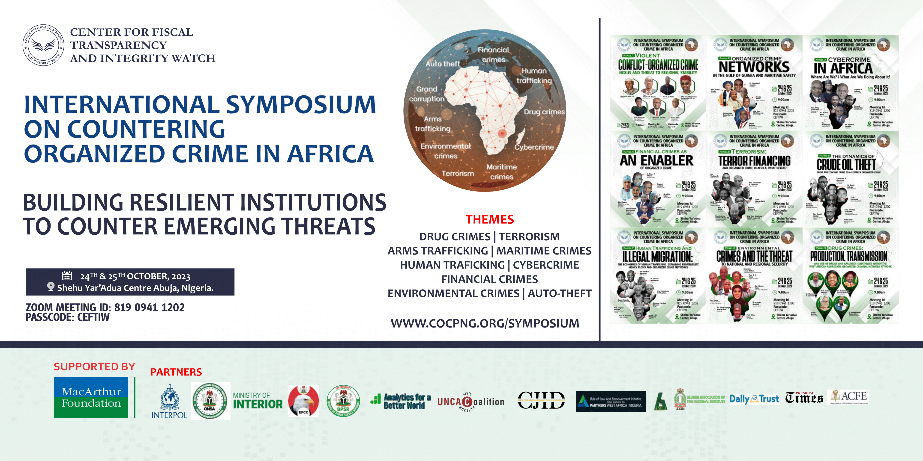

Slide 2
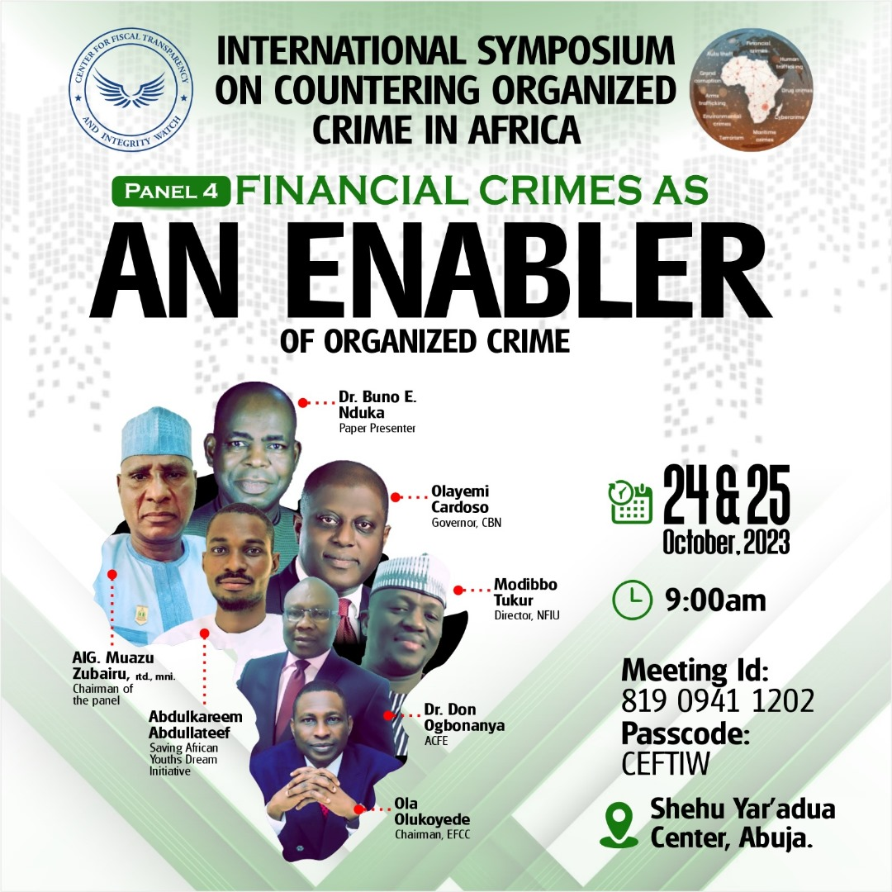

Slide 3
FINANCIAL CRIME AS ENABLER OF ORGANIZED CRIME
By
‘Buno E. NDUKA (Ph.D; CAMS; FCIN)
CHIEF CONSULTANT/CEO
MULTIVARIATE COMPLAINCE AND RESOURCE CENTRE (MCRC)
(FORMER DIRECTOR OF EVALUATION & COMPLIANCE, GIABA)
at
1ST INTERNATIONAL SYMPOSIUM ON ORGANISED CRIMES
OCTOBER 24 - 25, 2023, ABUJA, NIGERIA

Slide 4
PRESENTATION OUTLINE
Introduction
Conceptual Issues –Financial Crimes, Organized Crime, Enablers
Types of Organized Crime
Financial Crime-Organized Crime Nexus
Factors facilitating Financial Crime
Challenges in combating Financial Crime
Keeping Enablers of Financial Crime in check
Score Card of Nigeria in combating Financial crime
Way Forward in combating Financial crime in Nigeria
Conclusion

Slide 5
INTRODUCTION
The quest for wealth has beclouded morality and integrity of individuals and institutions
There has been increase in perpetration of several income generating crimes.
The consequences have been enormous and are inflicting hardship on citizens all over the globe.
  Lives and properties are lost
A 2020 Report of the UN Conference on Trade and Development (UNCTAD) stated that Illicit Financial Flows (IFFs) from Sub-Saharan Africa (SSA) is estimated at about US$88.6 Billion, about two times the overseas development assistance of about US$48 Billion.
Such looting are facilitated by enablers of Financial Crimes.
Unfortunately, in most cases, the actors that assisted the criminals to perpetuate these crimes are usually unaccounted for or not held accountable.

Slide 6
CONCEPTUAL ISSUES
What is Financial Crime?
What is Organized Crime?
Who are enablers of Financial Crime?
What is the relationship between Financial Crime and Organized Crime?

Slide 7
FINANCIAL CRIME
A range of illegal activities that are perpetrated through the financial system or institution for illicit profit
Criminal activities carried out by individuals or criminal entities to provide economic benefits through illegal methods
Any illegal activity that involves the use of the financial systems, institutions or instruments for illicit purposes, typically with the overall goal of generating profits for the perpetrators.
Criminal activities that involve money or other financial resources
7

Slide 8
ORGANIZED CRIME
A Continuing criminal enterprise that rationally works to profit from illicit activities
A planned and coordinated criminal behaviour and conduct by people working to together on a continuing basis with financial gain as the primary goal.
  Drug Trafficking; Terrorism, Illegal arms trafficking, Child Trafficking; Migrant Smuggling; etc.
Its continuing existence is maintained through the use of force, threats and/or corruption of public officials.
Is Financial crime because its objective is profit or other material gains.
8

Slide 9

FINANCIAL CRIME – ORGANIZED CRIME NEXUS
Illicit proceeds generated for Organized criminal group
Financial Crime
Organized Crime
Propel commission of Financial Crime

Slide 10
CATEGORIES OF FINANCIAL CRIME
Includes money laundering and most of its predicate offences (21 categories)
Participation in an organized criminal group and racketeering
Terrorism, including terrorist financing
Trafficking in human being and migrant smuggling including child trafficking
Sexual exploitation, including sexual exploitation of children and prostitution
Illicit trafficking in narcotic drugs and psychotropic substances
Illicit arms trafficking
Illicit trafficking in stolen and other goods
Corruption and bribery
Fraud (including cyber crime/Internet, 419; etc)
Counterfeiting currency
Counterfeiting and piracy of products
Environmental crime
Murder, grievous bodily injury
Kidnapping, illegal restraint and hostage-taking for ransom
Robbery or theft
Smuggling
Extortion (eg. Blackmail)
Forgery
Piracy (including maritime)
Insider trading and market manipulation
Tax Crime (related to direct and indirect taxes) & excise evasion
The two most significant types of financial crime are money laundering and terrorist financing
In 2021, President Biden of the USA noted that corruption depletes global annual GDP by an estimated 2-5%.
Corruption is a national security threat, hence calls out enablers who facilitate it through shell companies; opaque financial systems, and professional services
10

Slide 11
PREVALENT FINANCIAL CRIMES AND VULNERABLE SECTORS IN NIGERIA
The MER (Para 3 - 5) of Nigeria (2021) and NIRA (2022; Page 10) revealed that most prevalent ML predicate crimes and vulnerable sectors in Nigeria are:
PREDICATE OFFENCES
Corruption and Bribery,
Fraud and Cybercrime,
Drug trafficking,
Theft and Robbery,
Illicit Arms trafficking,
Environmental crimes (Oil bunkering; illegal mining; etc.)
Human trafficking
Forgery
Participation in organized crimes
Terrorist Financing
Tax crime
  VULNERABLE SECTORS
  Banking
  Real Estate
  Virtual Assets Service Providers (VASPs)
  International Money Transfer Operators (IMTOs)
  Bureau de Change (BDC)
  Car Dealers
  Dealers in Precious Stones and Metals
  Casinos/Lottery
  Trust & Company Service Providers (TCSPs)
  Extractive Sectors
11

Slide 12
ENABLERS OF FINANCIAL CRIME …./1
Consist of both the Threats and Vulnerabilities.
Persons (natural and legal), mechanisms and elements of a system, whether intentional or inadvertent, that play important role in facilitating the commission of the crimes thus increasing the benefits and scale, while reducing the risk of detection.
A threat is a person or group of people, object or activity with the potential to cause harm or damage or instability to the state, society, the economy, etc.
  Includes criminals, terrorist groups and their facilitators, their funds, as well as past, present and future ML or TF activities.
Threat serves as an essential starting point in developing an understanding of ML/TF risk.
  Vulnerabilities comprise those things that can be exploited by the threat or that may support or facilitate its activities
  Vulnerabilities could be through:
      Legal framework and OEMs
      Enforcement and Supervisory Actions
      Operational processes
      Products and Services
      Human resources
12

Slide 13
ENABLERS OF FINANCIAL CRIME …/2
Enablers are like gatekeepers of the financial system where willful, complicit or negligent conduct can provide opportunities for criminals to launder their illicit proceeds.
Financial crime can be facilitated by professional enablers – individuals and entities – through which potential users of the system must pass through in order to be successful (FATF, 2010).
Professional enablers may operate as individuals, an organisation or a network of professionals in financial or non-financial sector (FATF, 2018)
These professional enablers occupy privileged positions to identify, detect and prevent suspicious transactions.
Enablers include:
  Financial Institutions
  DNFBPs
  Professional money launders
13

Slide 14
EXAMPLES OF FINANCIAL CRIME
In a Report in 2022, FinCen revealed that between 1999 and 2017, global banks moved more than US$2 Trillion in payments believed to be suspicious and flagged bank clients in about 170 countries who were identified as being involved in potentially illicit transaction;
  Banks still move illicit cash for shadowy characters and crminial networks even after they were fined for failure to stop the flow of illicit proceeds.
Using Gravity Model, Fewerda et al (2020) estimated that about US$2333 trillion are laundered globally.
Financial Crime the following:
(a) The State
(b) Businesses (legal persons and arrangements)
(c) Individuals (Natural persons)
14

Slide 15
WHERE DO FINANCIAL CRIMES OCCUR
In a country or jurisdiction with lax or ineffective AML/CFT regime
  Low political commitment or will
  Lack of comprehensive legal framework,
  Poor understanding of consequences of ML/TF,
  Low risk of detection
  Complex financial system
  Poor governance structure (Lack of transparency, accountability; rule of law; etc.)
  Lack of appropriate supervisory regimes
  Inappropriate preventive measures
  Inefficient legal system;
  Enforcement challenges, etc.
Every country is a target (no country is immune to financial crime)

Slide 16
EFFECTS OF FINANCIAL CRIMES
Lack of resources for the provision of basic public goods (Schools; Healthcare facilities; Housing; roads; etc.)
Increase in cost of governance (enforcement actions; national defence; social costs; etc.)
Weaken legitimate government
Lead to shift in balance of economic power from responsible and responsive entities to rogues who have no political or social accountability
Loss of revenue to government
Heightened insecurity (armed banditry; kidnapping; armed robbery, etc.) thus increase in cost of personal safety and reduction in spending for other needs.
Weaken the financial Institutions
Scare away foreign investors and reduce a country’s access to both investment and foreign markets
Negative image of a country at int’l level
Increase in crimes and corruption

Slide 17
ROLES OF ENABLERS OF FINANCIAL CRIME
FATF (2010) noted that the status of professional enablers is vital in processing the various functions that assist criminals to move and clean dirty money.
Criminals take advantage of enablers’ specialized knowledge and expertise to identify and exploit gaps in legal frameworks, realize their objective and eventually legitimize their ill-gotten wealth.
In some cases, the criminals rely on the personal reputation of the enablers to prevent suspicion or even detection of criminal activities because of their perceived credibility.
17

Slide 18
THE KEY PILLARS OF COMBATING FINANCIAL CRIME
1
DETECT
Reduce the Profit Incentives
  limit the opportunities open to make money
3
2
DISRUPT
DETER
Disrupt Activities
  Apply all available means
Increase the risk
  Target major enablers with proportionate and dissuasive sanctions
18

Slide 19
KEEPING ENABLERS OF FINANCIAL CRIME IN CHECK …/1
Involves multi-facetted approach including targeting enablers with internationally acceptable measures especially the FATF Standards on:
TECHNICAL COMPLIANCE
AML/CFT Policies and Coordination (R1-R2)
Money Laundering and Confiscation (R3-R4)
Terrorist Financing and Financing of Proliferation (R5-R8)
Preventive Measures (R9-R23)
Transparency and Beneficial Ownership of Legal Persons and Arrangements (R24-R25)
Powers and Responsibilities of Competent Authorities and other institutional measures (R26-R35)
International Cooperation (R36-R40)
  EFFECTIVENESS OF THE SYSTEM
Risk and Coordination (IO1)
International Cooperation (IO2)
Supervision (IO3)
Preventive Measures (IO4)
Beneficial Ownership (IO5)
Financial Intelligence (IO6)
ML Investigation and Prosecution (IO7)
Confiscation (IO8)
TF Investigation and Prosecution (IO9)
TF Prevention (NPOs) (IO10)
Proliferation Financing (IO110
19

Slide 20
KEEPING ENABLERS OF FINANCIAL CRIME IN CHECK …/2
The FATF and the Global AML/CFT&PF Network track the implementation and effectiveness of each country’s AML/CFT&PF system through Mutual Evaluation.
Countries with weak regulation and limited implementation have been identified as places with the greatest risks of financial crimes .
The FATF through its ICRG platform has classified these countries into two broad groups – Grey List and Black List: As at June 23, 2023:
  Grey list - calls for increased monitoring (about 26 countries Including Nigeria)
  Black List – subject to greater pressure and likelihood of application of counter-measures through an international call for action (3 countries – DPRK; Iran and Myanmar).
Financial Transactions with businesses in these countries may face enhanced due diligence
20

Slide 21
SCORE CARD OF NIGERIA COMBATING FINANCIAL CRIMES (MUTUAL EVALUATION)

Slide 22
TECHNICAL COMPLIANCE WITH FATF 40 RECOMMENDATIONS BY NIGERIA
R1 | R2 | R3 | R4 | R5 | R6 | R7 | R8 | R9 | R10
PC | PC | PC | C | LC | PC | NC | NC | C | LC
R11 | R12 | R13 | R14 | R15 | R16 | R17 | R18 | R19 | R20
PC | PC | C | C | PC | LC | LC | LC | PC | PC
R21 | R22 | R23 | R24 | R25 | R26 | R27 | R28 | R29 | R30
LC | PC | PC | PC | PC | LC | LC | PC | C | C
R31 | R32 | R33 | R34 | R35 | R36 | R37 | R38 | R39 | R40
C | PC | PC | PC | LC | LC | LC | LC | LC | LC
SUMMARY
RATING | NO.
C | 7
LC | 14
PC | 17
NC | 2

Slide 23
EFFECTIVENESS OF NIGERIA AML/CFT SYSTEMS
IMMEDIATE OUTCOME (IO) | FOCUS | RATING
IO 1 | Risk and Coordination | LE
IO 2 | International Cooperation | LE
IO 3 | Supervision | ME
IO 4 | Preventive Measures | LE
IO 5 | Beneficial Ownership | LE
IO 6 | Financial Intelligence | ME
IO 7 | ML Investigation and Prosecution | LE
IO 8 | Confiscation | LE
IO 9 | TF Investigation and Prosecution | LE
IO 10 | TF Prevention (NPOs) | LE
IO 11 | Proliferation Financing | LE

Slide 24
HIGHLIGHTS OF MAIN DEFICIENCIES IN NIGERIA’S AML/CFT REGIME
Underdeveloped understanding of the risk of financial crimes considering the complexity, materiality and scope of the crimes;
Limited use of financial intelligence by LEAs due to:.
  Limited scope of entities that file STR
  Low level of feedback by LEAs to the NFIU
  Limited scope of institutions from which the NFIU can request additional information to support its analyses
Limited or lack of coordination among the several agencies (EFCC; ICPC; NDLEA; NAPTIP; etc.) designated to investigate and prosecute financial crimes. Thus ,
  ML investigation is not prioritized instead focus is on the predicate offence
  Autonomous/standalone ML cases are not pursued
Number of investigations, prosecutions and convictions for ML is inconsistent with the risk profile of the country
Limited sanctions against enablers (financial institutions, DNFBPs) for non-compliance with AML/CFT requirements
Ineffective legal and operational framework for seeking international cooperation including the recovery and repatriation of assets.
Lack of explicit policy to confiscate the proceeds and instrumentalities of crime or property of equivalent vale
Incomprehensive legal framework on asset-sharing and formal arrangement for asset sharing with foreign countries for purpose of restitution
Inadequate resources for competent authorities (NFIU; SCUML) to undertake the responsibilities
Incomplete understanding of TF threats and risks
  Lack of adequate insight into Boko/ISWAP’s international linkage and abuse of formal financial system
  Non-prioritizing of TF investigations
  Low effectiveness of the designated authorities responsibility with TF activity
  Non-value addition of TF-related STRs filed to NFIUs and thus little value to CFT efforts

Slide 25
RECOMMENDED ACTIONS …/1
Review the extant legal frameworks and infrastructure (National constitutions; AML/CFT laws; OEMs; etc.) to ensure their comprehensiveness, clarity and delineation of powers, roles and responsibilities that would promote good governance; facilitate effective supervisions; operational modalities; etc.
Institutional Strengthening - establishment of functional, independent and autonomous institutions (Judiciary; Law Enforcement Agencies; Financial Intelligence Units; Customs; Supervisory and Regulatory agencies; Corporate Affairs Commission; Supreme Audit Institutions (Auditor-General); Electoral Bodies (INEC); Anti-Graft Agencies (EFCC; ICPC); etc.) to promote the rule of law; engender confidence of citizens in the institutions.
  As a former US President once said, “Africa needs strong institutions and not just strong individuals”.
Establishment of specialized institutions (FinCrime Courts, Asset Mgt Agency; etc.) with defined mandate.
Improvement in national cooperation, coordination and collaboration at both operational and policy levels and inter-Agency collaboration.
Improvement in international cooperation (information sharing including intelligence; mutual legal assistance; extradition; etc.) that would facilitate “follow the money “ involving tracing; investigation; prosecution, conviction and recovery
Regular review of the NRA to incorporate emerging ML/TF risks especially VAs; VASPs; NPOs at Risk; Bos.
Conduct of more studies on Financial Crimes including sectoral and thematic studies and typologies
Good Asset recovery and management framework (efficient; transparent; etc.).
Enhanced public-private sector collaboration in the implementation of effective measures
25

Slide 26
RECOMMENDED ACTIONS …/2
Deployment of effective preventive mechanism by reporting entities involved in financial intermediation (appropriate CDD measures; risk management; treatment of Politically Exposed Persons; Suspicious Transaction Reporting obligations ; Record Keeping; etc.)
Appropriate regulatory and supervisory framework covering all sectors including proper supervision of Gatekeepers (Accountants; Legal professionals; etc.); electoral programs (electoral integrity; election funding -“conduit contributions” – political campaign; etc.)
Application of appropriate sanctions (dissuasive, effective and proportionate) to deter criminals and prevent repeat of crime.
Holistic and integrated approach to capacity building of all stakeholders (Judiciary; LEAs; Supervisors/regulators; CSOs; youths; etc.) especially on parallel financial investigations.
Availability of adequate resources for AML/CFT matters especially the provision of adequate tools to competent authorities (NFIU; SCUML)
Adequate preparation for Mutual Evaluation (Use of Experienced Team; Self-Mutual Evaluation if resources permit)
Availability and access to information (e.g: access to beneficial ownership information - timely; comprehensive; publicly available; etc.).
  The Panama and Paradise papers revealed offshore links of some world’s most powerful people and companies and exposed offshore holdings of political leaders, billionaires, celebrities and household names and companies.
26

Slide 27
NIGERIA IN THE FATF ICRG PROCESS
NIGERIA
Following the Adoption of the MER in August 2021, Nigeria was rated as follows:
Banking sector assets - USD 93.76 billion
Commencement of Observation Period – October 2021.
End of Observation Period – October 2022
First FUR – adopted in November 2022
Due Date for Post Observation Progress Report (POPR) – February 2023.
2nd FUR – for discussion and adoption in November 2023
FATF REC | R3 | R5 | R6 | R10 | R11 | R20
Rating | PC | LC | PC | LC | PC | PC

Slide 28
PROGRESS BY NIGERIA SINCE ENTERING THE FATF ICRG PROCESS – GREY LIST
Nigeria has made significant progress in addressing the identified deficiencies in its AML/CFT regime.
Out of 84 recommended actions, less than 20 remain to be addressed as at Feb 2023.
Conduct of all inclusive national Ml/TF Inherent risk assessment (NIRA) for 2019 – 2021.
  NIRA Report adopted in 2022
  All sectors vulnerable to ML/TF assessed (eg. NPOs at risk; Legal persons and arrangements; etc.)
Several new Legal framework enacted
  MLPPA (2022)
  TFPPA (2022)
  POCA (2022)
Identification and designation of agencies and timelines to address identified deficiencies.
AML/CFT Strategic Implementation Roadmap reviewed incorporating findings in the NIRA
Several regulations developed. Eg.
  Regulations and Guidelines for TFS – TF and PF
  Regulations on Persons with Significant Control (PSC)
Most of the Big 6 Recommendations have been re-rated upwards.
  As at Nov 2022 (1st FUR), only R6 remains to be upgraded.
Several AML/CFT Policies developed to address some major high priority areas:
  Counter-Financing of Terrorism Strategy
  International Cooperation Policy
  National Policy for the confiscation of Proceeds and Instrumentalities of Crime and Property of corresponding value
  NDLEA Drug Control Masterplan
  Standard Operating Procedure on Parallel Financial Investigation and Exchange of Information
Establishment and Effective functioning of AML/CFT Organs and Platforms
  IMC – Inter Ministerial Committee
  NSC – Nigeria Sanction Committee
  AOF – Authorised Officers Forum
  ACCOBIN – Association of CCOs of Banks in Nigeria
  CCOCIN – Committee of Chief Compliance Officers of Capital Market Operators in Nigeria
Several capacity building activities for stakeholders

Slide 29
TAKE AWAYS FOR NIGERIA
It is not enough to enact new legislations; develop guidelines and establish institutions, but to ensure that the system is delivering the desired outcomes
EFFECTIVENESS! EFFECTIVENESS!! EFFECTIVENESS!!!
Efficient judiciary in adjudication of Financial Crime cases
Good use of intelligence and appropriate feedback
Establish an integrated operational response with clearer processes for prioritizing, tasking and assessing performance
Ensure greater clarity of roles and responsibilities in relation investigation and prosecution of financial crimes.
Reduce information overload– regulatory overdose for reporting entities
Qualitative STRs by reporting entities – Not “Get-out-of Jail-Free Card”
Political Commitment

Slide 30

CONCLUSION
CONCLUSION
All stakeholders should work in a concerted and collaborative manner to ensure that combating Financial Crime is national priority
Notes:
30

Slide 31
End of Presentation
Thank you for
your attention

