Slide 1
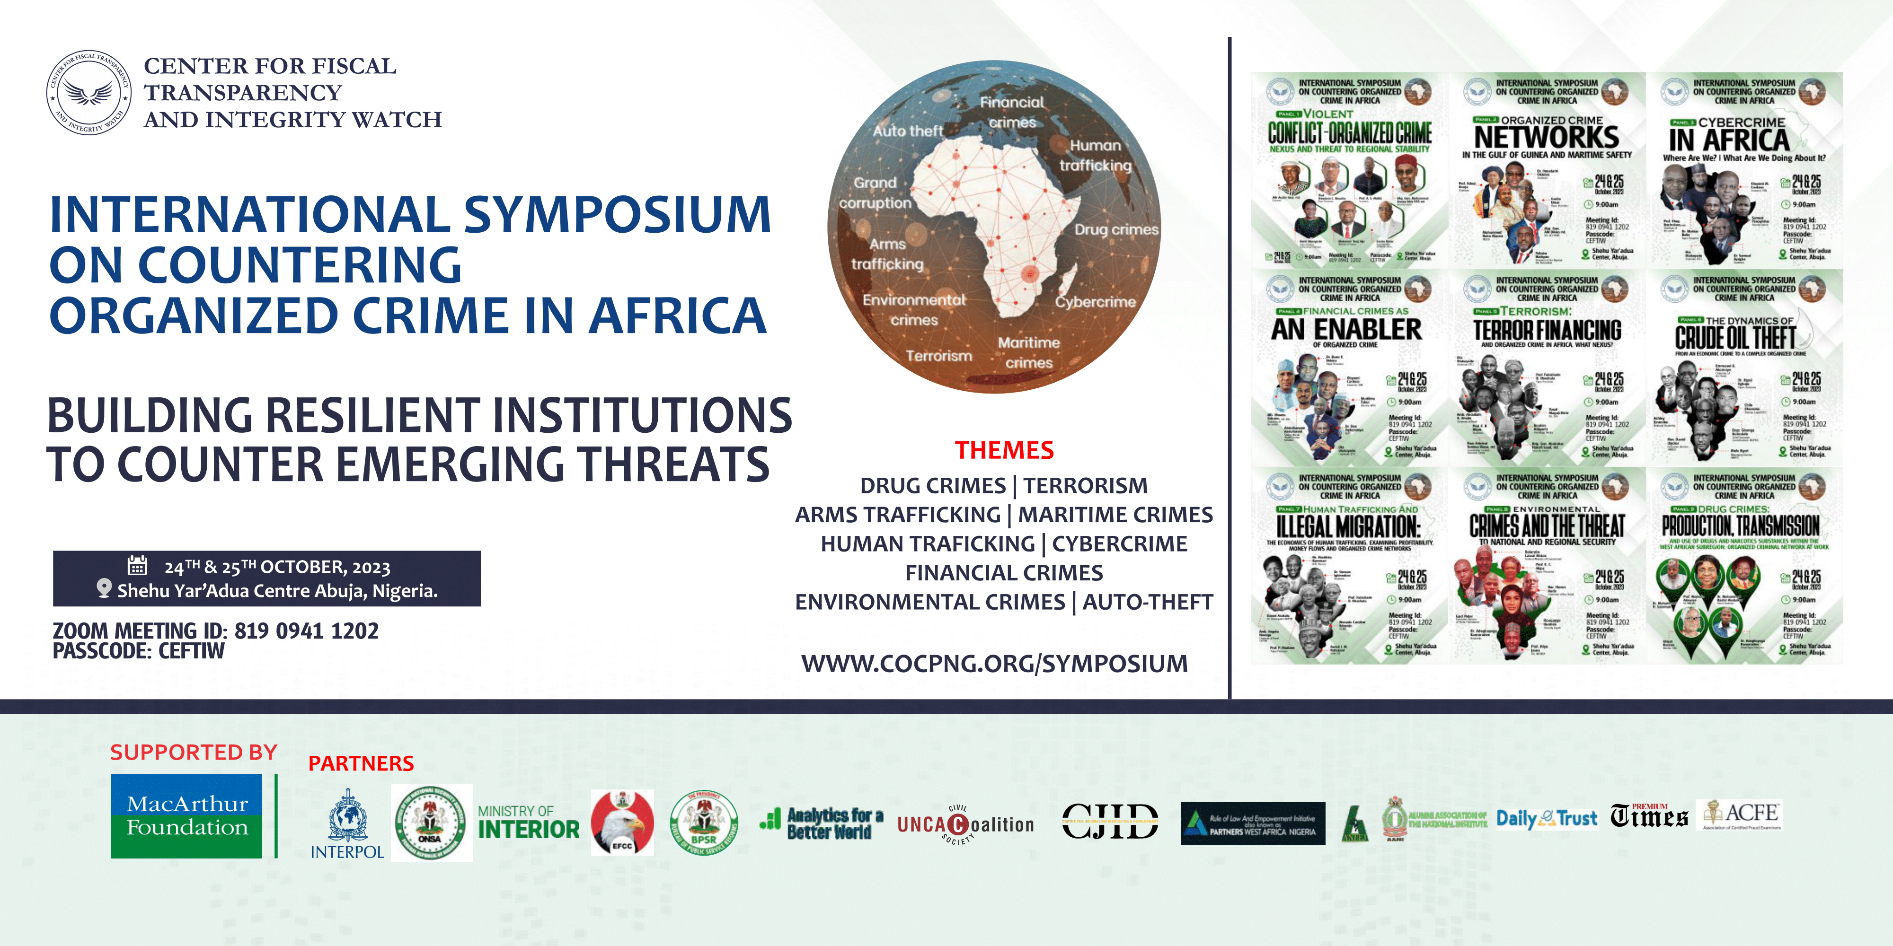

Slide 2


Slide 3
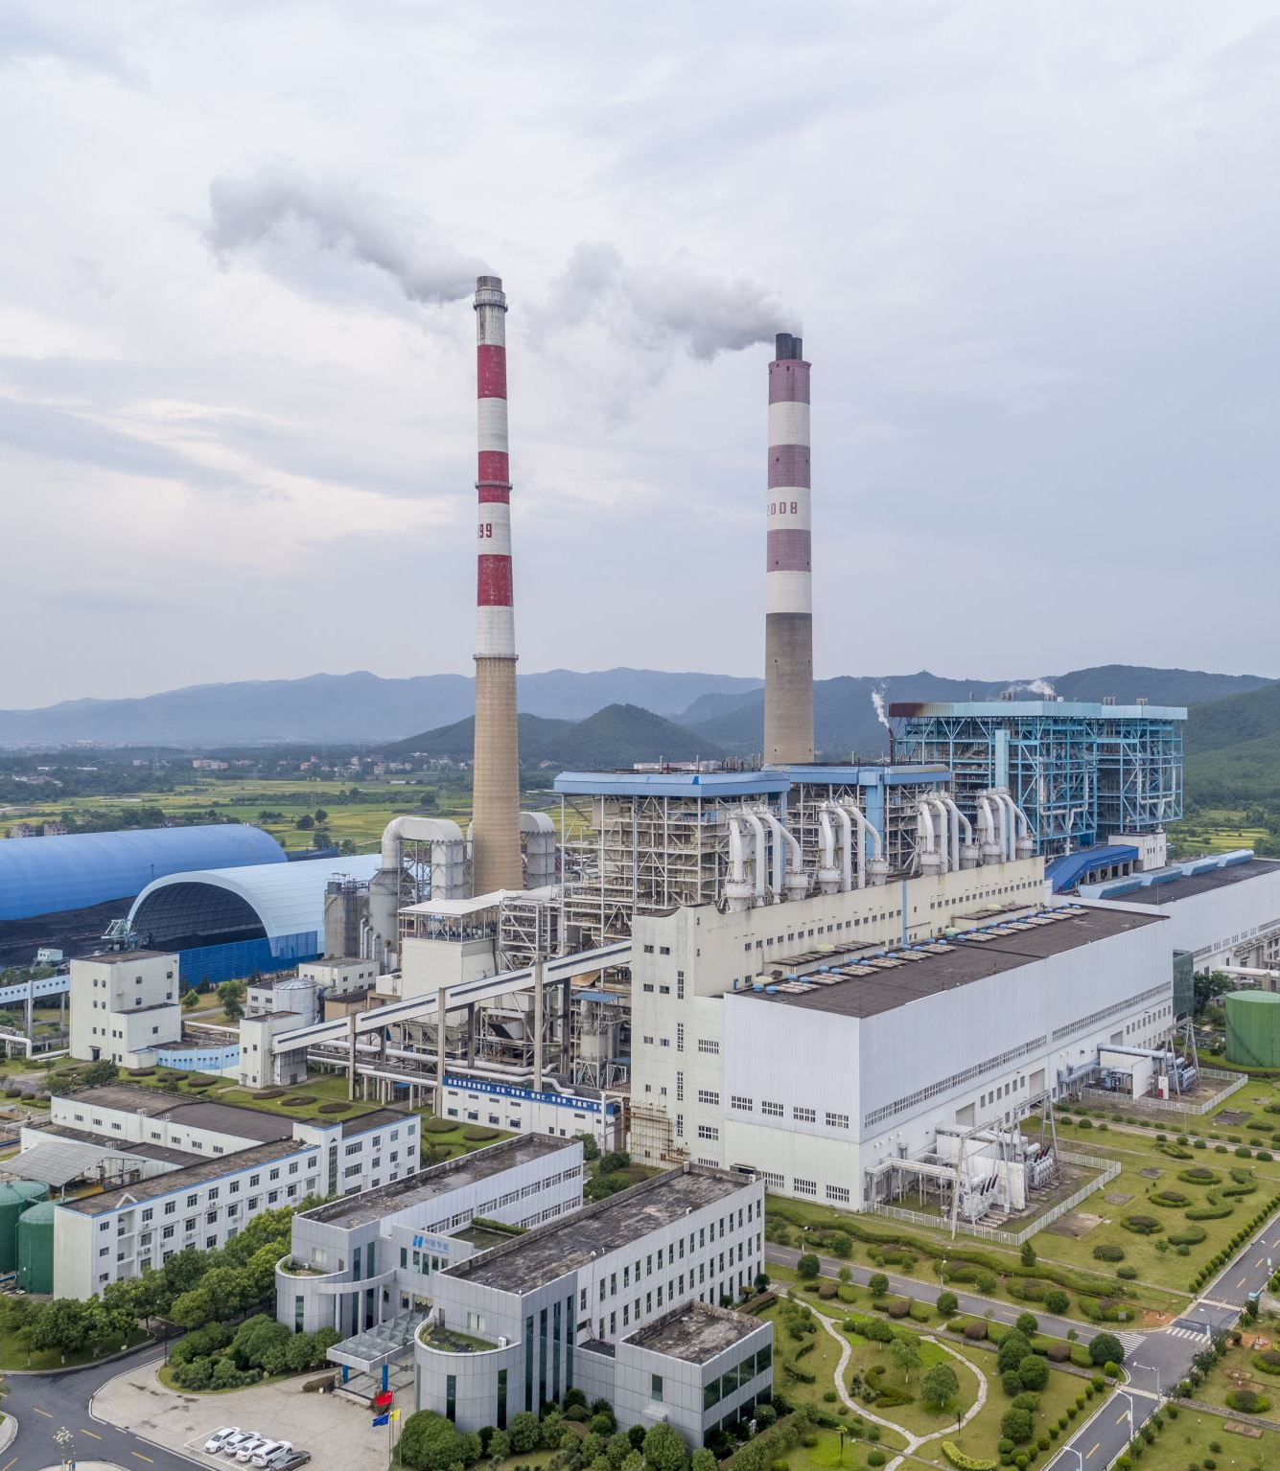
ENVIRONMENTAL CRIME AND THREAT TO NATIONAL AND REGIONAL SECURITY
PRESENTED BY
PROF. EUGENIA CHIKA AKPA
AT
THE 1ST INTERNATIONAL SYMPOSIUM ON COUNTERING ORGANIZED CRIME IN AFRICA
ORGANIZED BY
CENTER FOR FISCAL TRANSPARENCY AND INTEGRITY WATCH

Slide 4
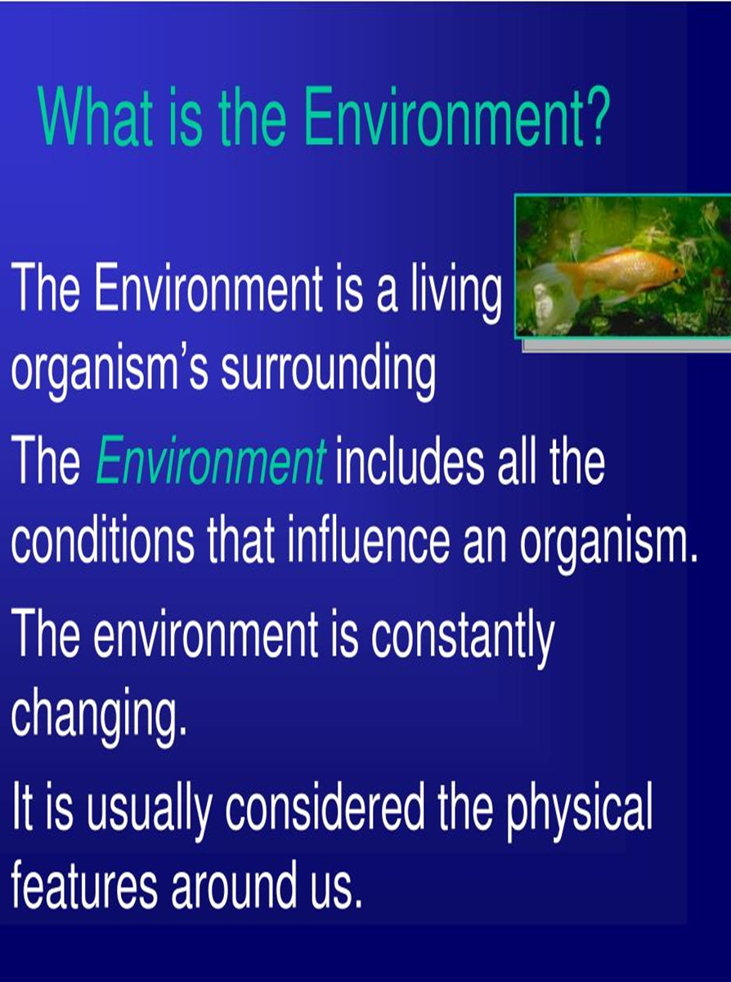
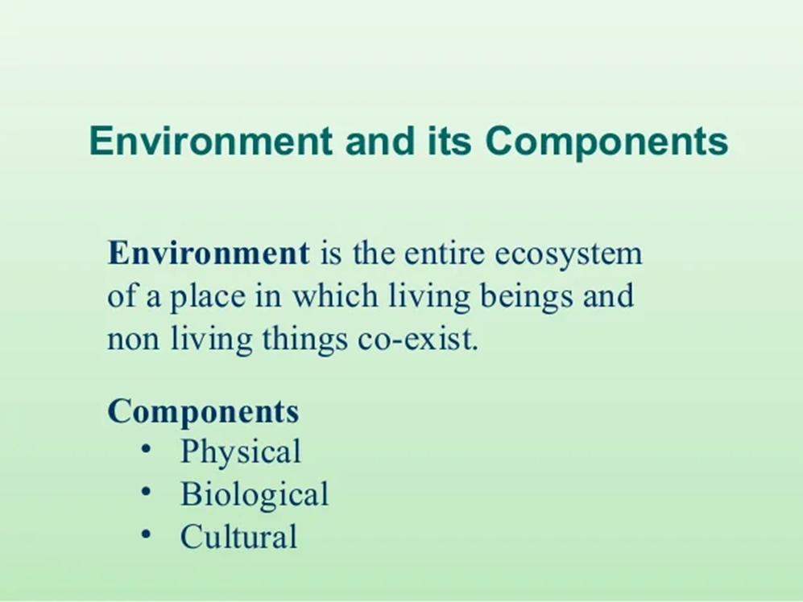

Slide 5
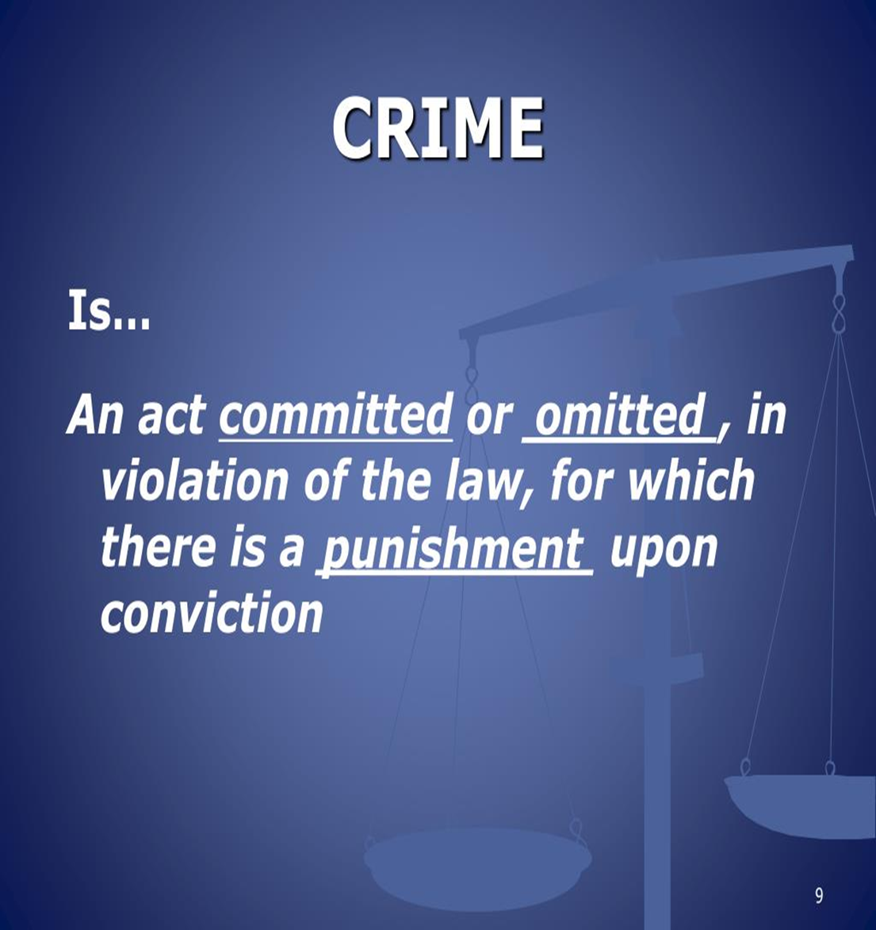
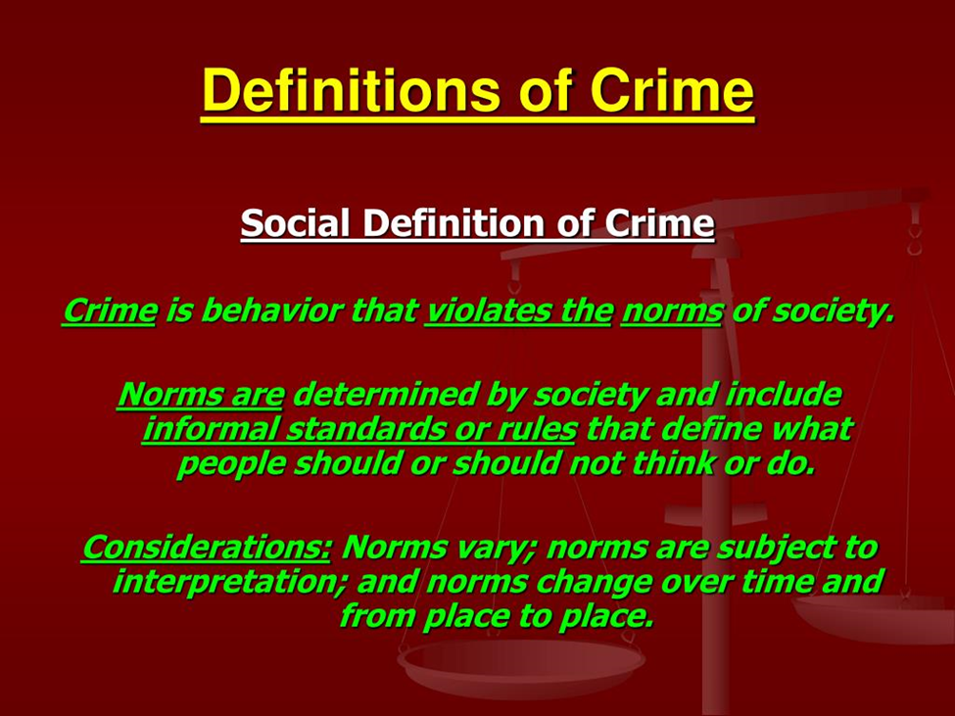

Slide 6
Environmental crimes
Environmental crimes are illegal activities that harm the environment and its inhabitants

Slide 7
Environmental crime involves the violation of laws put in place to protect the environment and wildlife within a given jurisdiction.
Typically, environmental crimes include the exploitation or trafficking of resources or animals for profit and can be organized into crimes involving the climate, forests, oceans and wildlife.

Slide 8
SEVERITY OF ENVIRONMENTAL CRIME
Environmental crime is a serious and growing international problem that affects all sectors of the society and has negative impacts on security and development.
According to the UN Environment Programme (UNEP) and INTERPOL, environmental crime is the fourth largest criminal activity in the world, worth up to USD 258 billion, and is increasing by five to seven per cent every year.

Slide 9
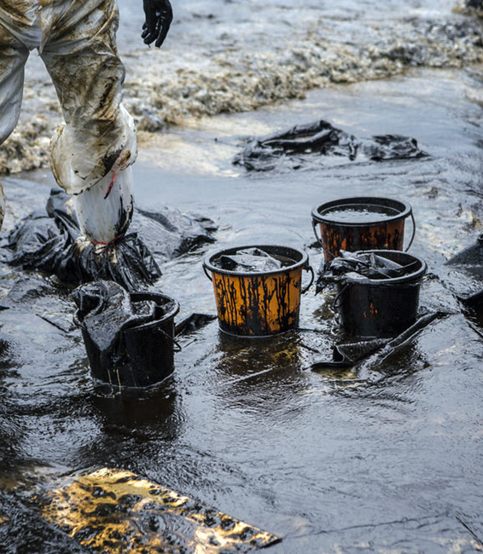
Classifications of Environmental Crime
Pollution crimes: These are crimes that involve the release of harmful substances into the environment, such as air, water, or soil pollution. Examples include oil spills, dumping of hazardous waste, and illegal mining
Wildlife crimes: These are crimes that involve the illegal trade, poaching, or killing of wildlife. Examples include the illegal trade in ivory, rhino horns, and tiger bones
Forestry crimes: These are crimes that involve the illegal logging or destruction of forests. Examples include deforestation, illegal logging, and forest fires

Slide 10
Environmental Criminal Activities
Illegal mining and trade in minerals such as oil, gold, diamonds etc
Illegal logging/deforestation and trade in timber
Illegal dumping and trade of chemicals and waste
Unreported and unregulated fishing
Illegal wildlife and animal poaching
Illegal production and trade of ozone-depleting substances
Pollution of the atmosphere, oceans, rivers or earth

Slide 11
Consequences on EC
Health Hazards
Environmental Catastrophe on Host Communities
Destruction of the Ecosystem
Lose of National Wealth
Increased Climate Change Effect

Slide 12
Concept of National Security
External security - The protection of a state of all military and non-military threats that come out of its borders, from the international environment
Internal security - The protection of constitutional and legal system of the armed rebellion, separatist and other subversive activities of internal extremists
Individual safety - The protection of human rights and property of citizens
Societal security - The protection of individual identity and development of social groups
Economic security - Protection of economic order and the living standards of people
Civil protection - The protection of people and buildings from fire, flood, earthquakes, storms and other natural disasters
Health security - Protection of human health

Slide 13

Impact of EC on National Security
Environmental crime undermines the rule of law and governance, as it involves corruption, counterfeiting, cybercrime and other forms of organized crime
It weakens the state’s ability to provide security and justice for its citizens, and erodes public trust and confidence
Environmental crime fuels conflict and violence, as it provides a source of income and resources for non state armed groups
Environmental crime threatens sustainable development and human rights
Environmental crime affects the poor and vulnerable the most, as they depend on natural resources for their survival
Environmental crime also causes environmental degradation, biodiversity loss, climate change

Slide 14
Combating EC in Nigeria
Increasing formal surveillance using electronic alarms, CCTV, private security patrols or neighbourhood watch
Increasing natural surveillance by removing obstacles to line of sight or improving street lighting
Increasing access to exit controls available to criminal
Enhancing institutional capacity (training and retraining security personnel and equip them)
Strengthening the legal frameworks (punish crime convicts with appropriate law)
Increase collaboration and remove crime enablers
Raise awareness of wildlife crime and design alternative means of livelihood for dwellers of local communities

Slide 15
THANK YOU FOR LISTENING

