Slide 1
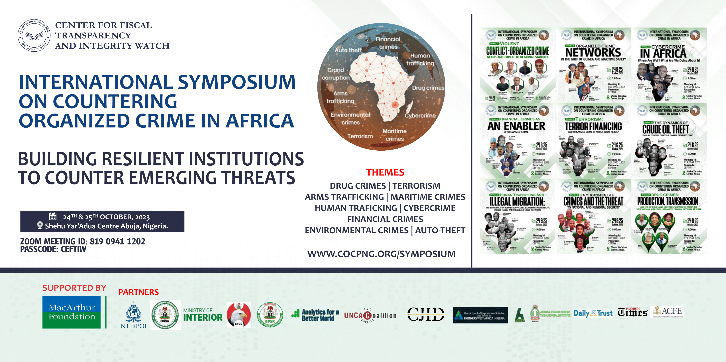

Slide 2
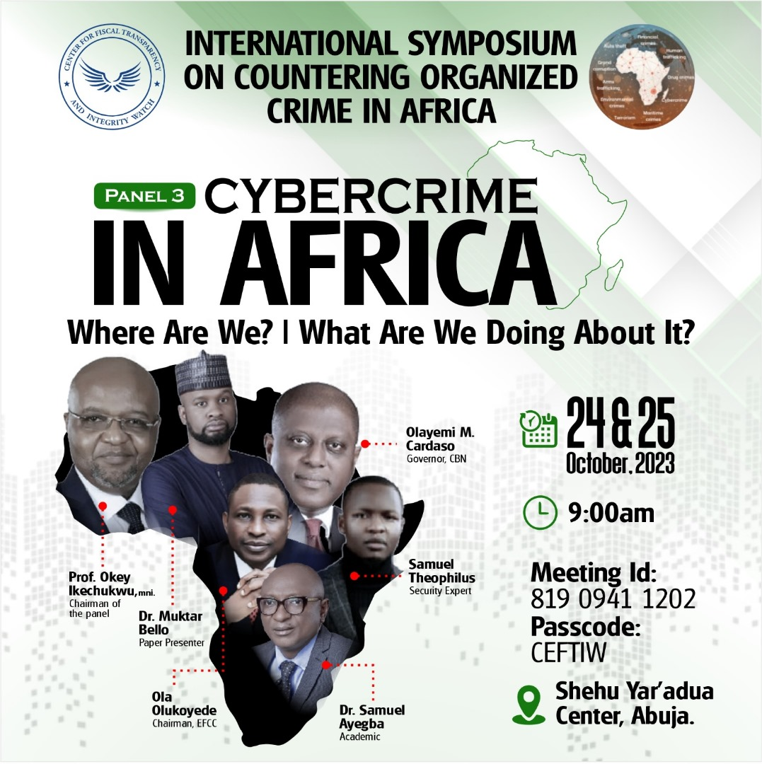

Slide 3

Cybercrime in Africa
Where Are We? | What Are We Doing About It?
Muktar Bello, PhD
24th October 2023
Paper Presented at the International Symposium on Countering Organized Crime in Africa – Building Resilient Institutions to Counter Emerging Threats

Slide 4
1N73LL1G3NC3
15 7H3
4B1L17Y
70 4D4P7 70
CH4NG3…

Slide 5


Slide 6
7H15 M3554G3
53RV35 70 PR0V3
H0W 0UR M1ND5 C4N
DO 4M4Z1NG 7H1NG5!
1MPR3551V3 7H1NG5!
1N 7H3 B3G1NN1NG
17 W45 H4RD BU7
Y0UR M1ND 15
R34D1NG 17
4U70M471C4LLY
W17H 0U7 3V3N
7H1NK1NG 4B0U7 17,
45 0NLY C3R741N P30PL3
C4N R34D 7H15
(- :…B3 PR0UD …:-)

Slide 7
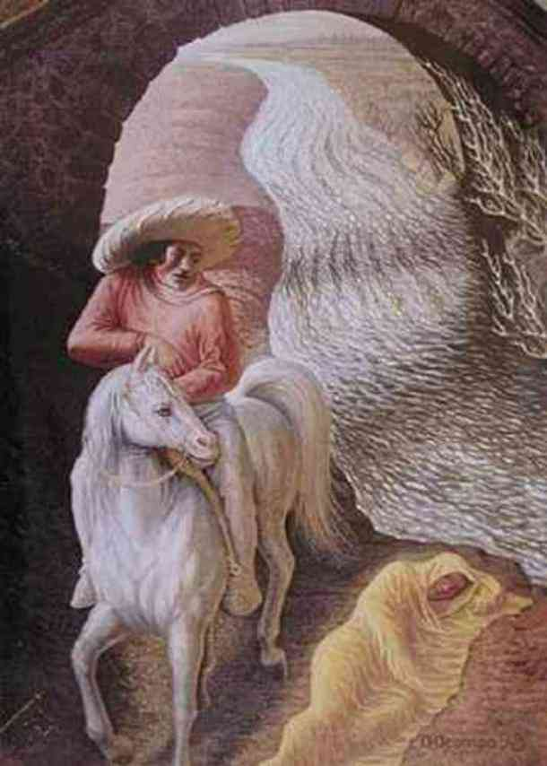
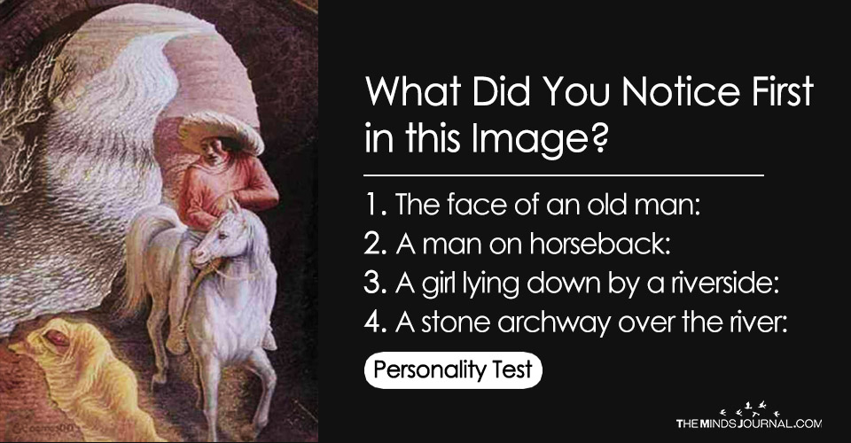

Slide 8
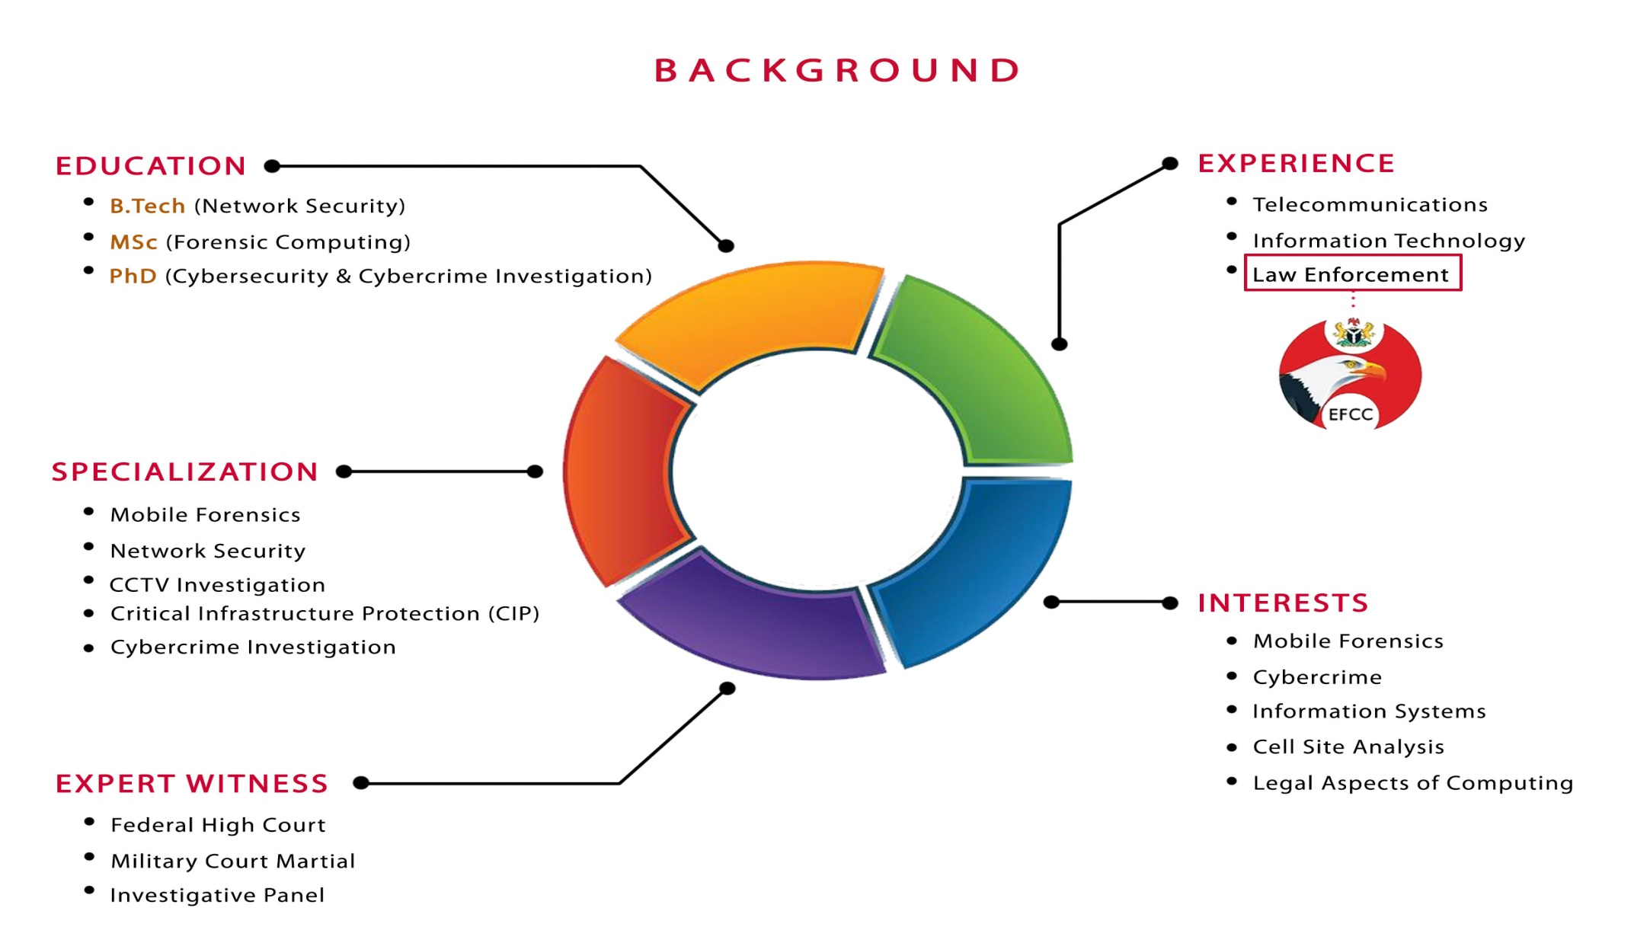



Slide 9
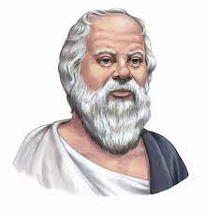
PHILOSOPHICAL QUOTE
CYBER-CRIME IN AFRICA
SOCRATES
“The only true wisdom is in knowing you know nothing”

Slide 10








AFFILIATIONS
PROFESSIONAL & ACADEMIC AFFILIATIONS
FORENSICS DEPARTMENT
LECTURER & RESEARCHER
EXPERT FORENSIC CONSULTANT
VISITING LECTURER
VISITING LECTURER
ACADEMIC ADVISORY BOARD
SUBJECT MATTER EXPERT
ISO 27001 SENIOR LEAD IMPLEMENTER

Slide 11
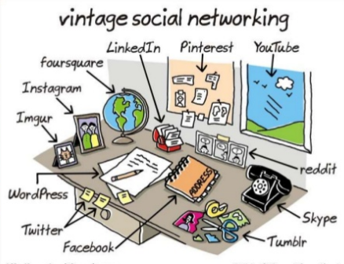
IN THE BEGINNING
CYBER-CRIME IN AFRICA

Slide 12
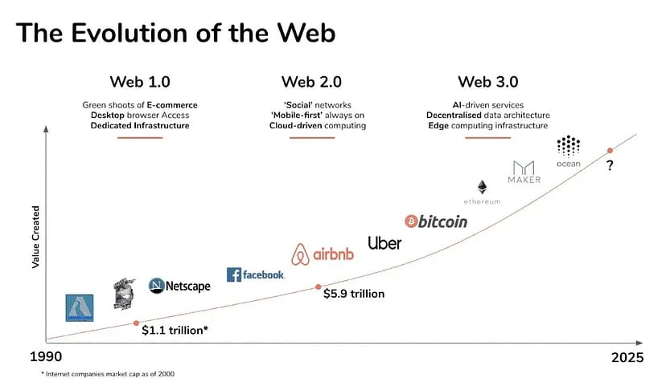
EVOLUTION OF THE WEB
CYBER-CRIME IN AFRICA

Slide 13
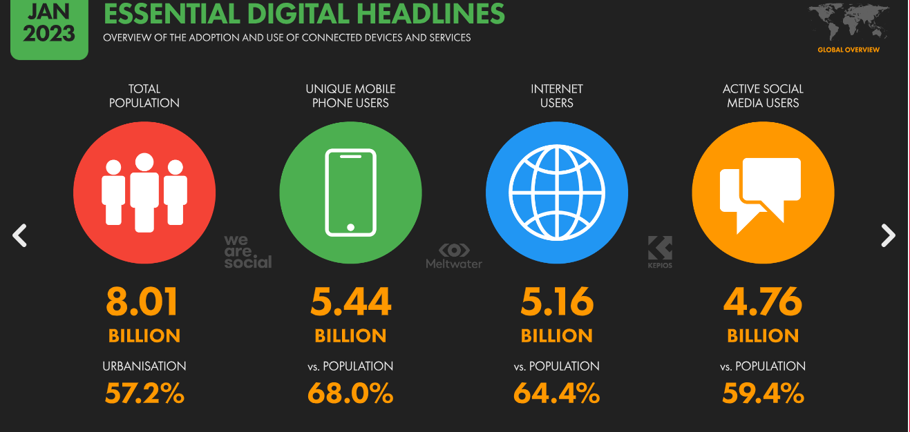

Slide 14
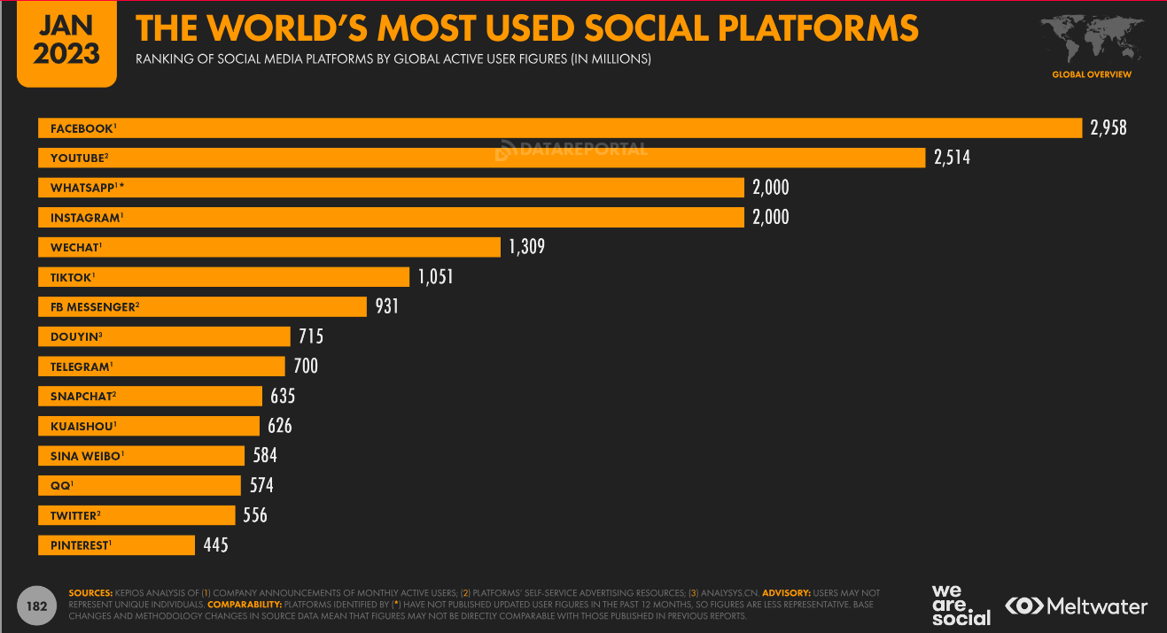

Slide 15

CYBERCRIME STATISTICS
CYBERCRIME IN AFRICA
POPULATION – 1.4 Billion
COST OF CYBERCRIME - $4B/YR
17.89% of the entire world population
It is estimated that it costs the South African economy $570m a year, Nigeria $500m and Kenya $36m
INTERNET USERS – 570M
GLOBAL TERRORISM INDEX
Burkina Faso (2nd) Somalia (3rd)
Mali (4th) Nigeria (8th) Niger (10th)

Slide 16
5 Vs – DATA
CYBER-CRIME IN AFRICA
VOLUME
01
Refers to the amount of data generated through websites, online applications, transactions, data saved in records, files etc
VERACITY
Integrity of Data
05
02
VELOCITY
The speed of data processing generated in real time, online and offline, in streams, batches or bits.
VALUE
Assets Valuation.
04
03
VARIETY
Refers to the different types of data including structured and unstructured data, online images and videos, human generated texts, machine generated readings etc.

Slide 17
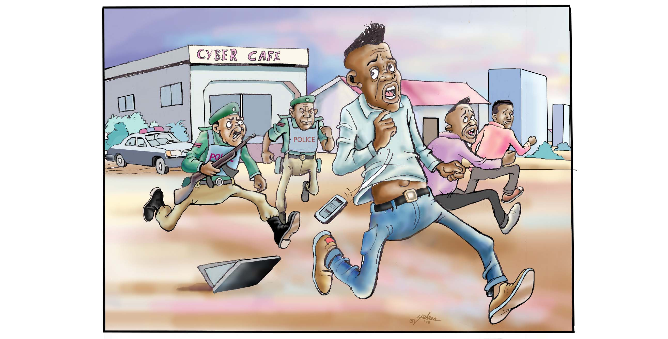
WHAT IS CYBER-CRIME?
CYBER-CRIME IN AFRICA

Slide 18
WHY DO PEOPLE COMMIT CRIME?
CYBER-CRIME IN AFRICA
CRIMINOLOGICAL THEORIES
Criminological theories focus on explaining the causes of crime. They explain why some people commit a crime, identify risk factors for committing a crime, and can focus on how and why certain laws are created and enforced.

Slide 19
CRIMINOLOGICAL THEORY - RAT
CYBER-CRIME IN AFRICA
ABSENCE OF A CAPABLE GUARDIAN
SUITABLE TARGET
MOTIVATED OFFENDER
Cohen and Felson (1979) argued that for crime to take place, three requirements needed to be present namely, a motivated offender, a suitable target and an absence of a capable guardian.

Slide 20
Where Are We?

Slide 21
SOCIAL ENGINEERING
CYBER-CRIME IN AFRICA
79% - 83%
PHISHING ATTACKS
TAKES 49 DAYS TO
IDENTIFY A CYBER-ATTACK
$6.9 BILLION IN 2021

Slide 22
CRIME, CRIMINALITY & TERRORISM
CYBER-CRIME IN AFRICA
ARMED ROBBERY
TERRORISM
ONLINE SEXUAL EXPLOITATION
OF CHILDREN
MODERN DAY SLAVERY
CYBER-CRIME
CYBER-WARFARE
CYBER-TERRORISM
BEC

Slide 23
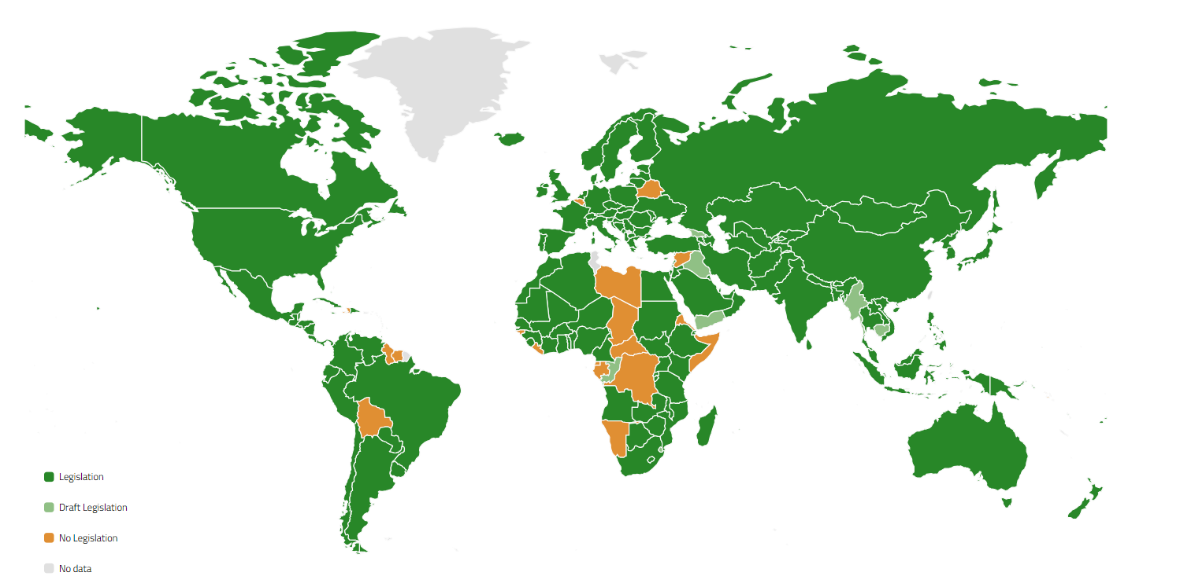
CYBERCRIME LAWS & POLICIES
CYBER-CRIME IN AFRICA

Slide 24





CASE STUDY 1: MOTIVATED OFFENDER: MR. HUSH
CYBER-CRIME IN AFRICA
SOCIAL MEDIA INFLUENCER
CYBER-CRIMINAL
MULTIPLE JURISDICTION
ONLINE EVIDENCE - INSTAGRAM

Slide 25
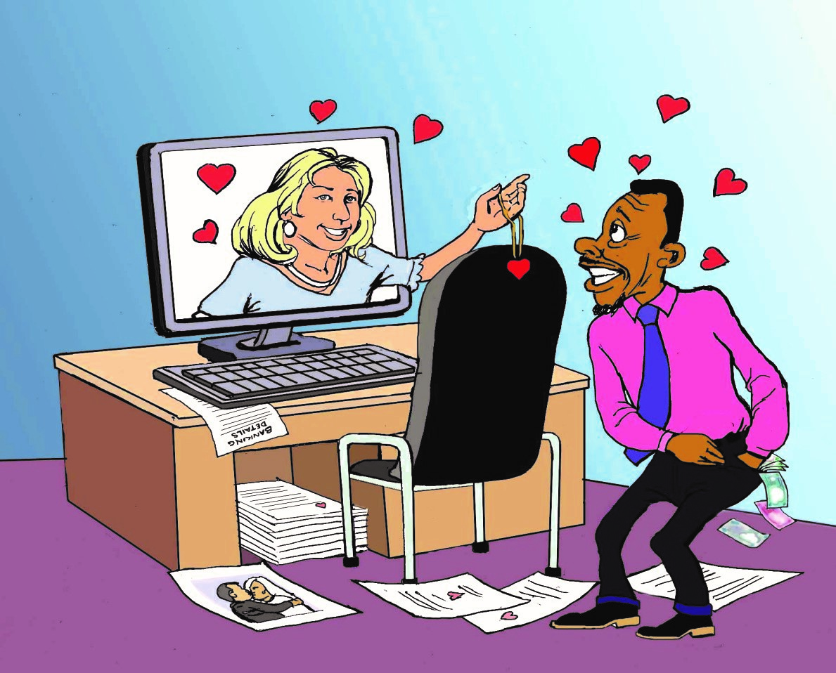
SUITABLE TARGET: SOCIAL ENGINEERING
CYBER-CRIME IN AFRICA

Slide 26
BOKO HARAM – ONLINE OR OFFLINE
CYBER-CRIME IN AFRICA
SOCIAL MEDIA PRIMARILY USED FOR PROPAGANDA
CONTENT FOCUSES ON
ON-GOING ATTACKS
OPERATIONAL VICTORIES
BEHEADING OF HOSTAGES
F
PREFERENCE OF TRADITIONAL MEDIA
PRE - 2015
Audio Cassettes, Leaflets, Open Air Lectures
E
SOCIAL MEDIA USE INFLUENCED BY:
INTERNET PENETRATION
OTHER FACTORS
G
D
USE OF SOCIAL MEDIA
POST - 2015
You Tube, Twitter & FaceBook
C
B
A
TWITTER RESULTS BETWEEN 2012 - 2017
BOKO HARAM – 159,095
NOT AS SOPHISTICATED AS ISIL
More Advanced after pledging to ISIL

Slide 27
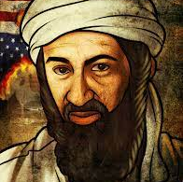
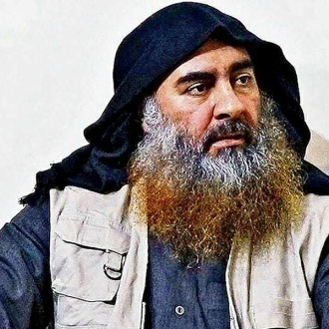
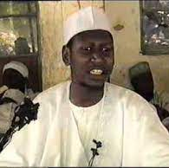
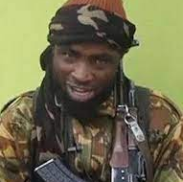
TERRORIST HALL OF FAME
CYBER-CRIME IN AFRICA
What have we learnt?
OSAMA BIN LADEN
ABUBAKAR AL-BAGHDADI
MOHAMMED YUSUF
ABUBAKAR SHEKAU
AL – QA’IDA
ISIS
BOKO HARAM
BOKO - HARAM

Slide 28
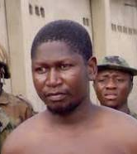
CASE STUDY 2: KILLING OF BOKO HARAM LEADER
CYBER-CRIME IN AFRICA
Alleged Killing by LEA
Evidence Based on Video
5 Police Officers Charged
Defendant discharged & Acquitted

Slide 29
LACK OF A CAPABLE GUARDIAN
CYBER-CRIME IN AFRICA
1
ARE LAW ENFORCEMENT CAPABLE GUARDIANS?
2
CRITICAL INFRASTRUCTURE PROTECTION
3
DIGITAL TRANSFORMATION/TECHNOLOGY
4
POLICIES & LAWS

Slide 30
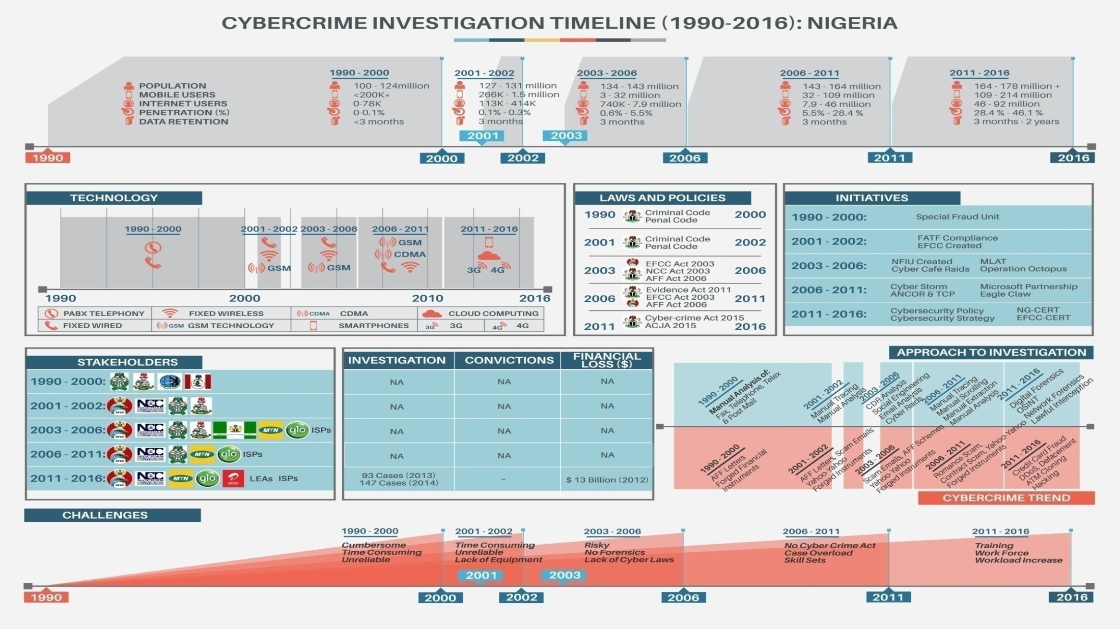

Slide 31
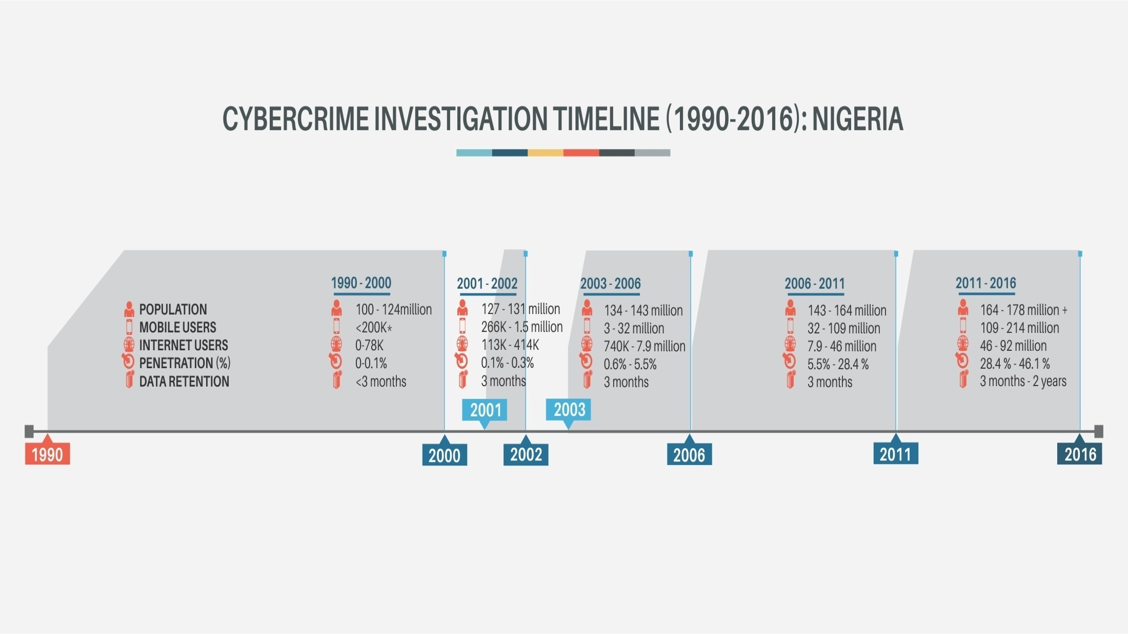

Slide 32
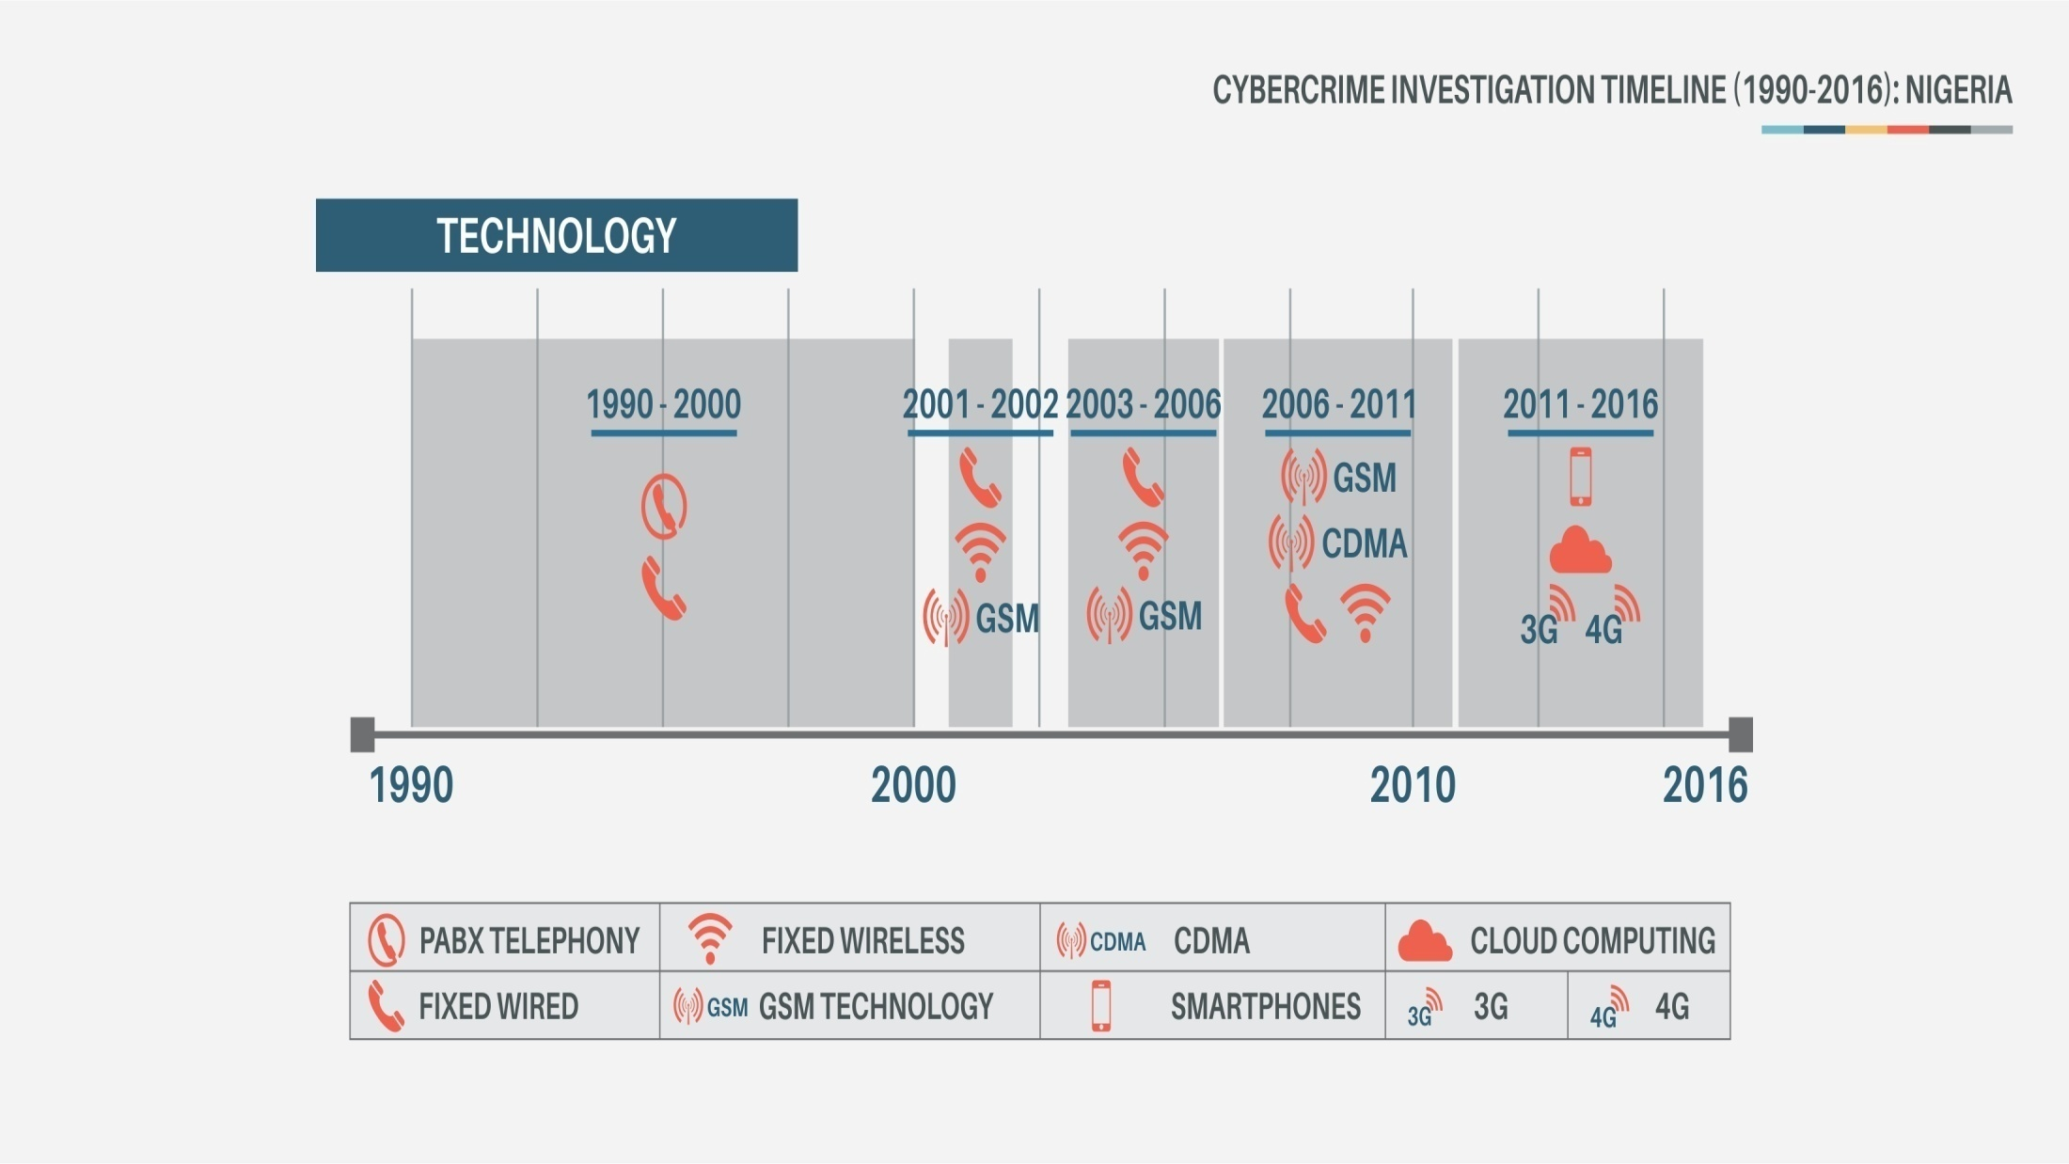

Slide 33
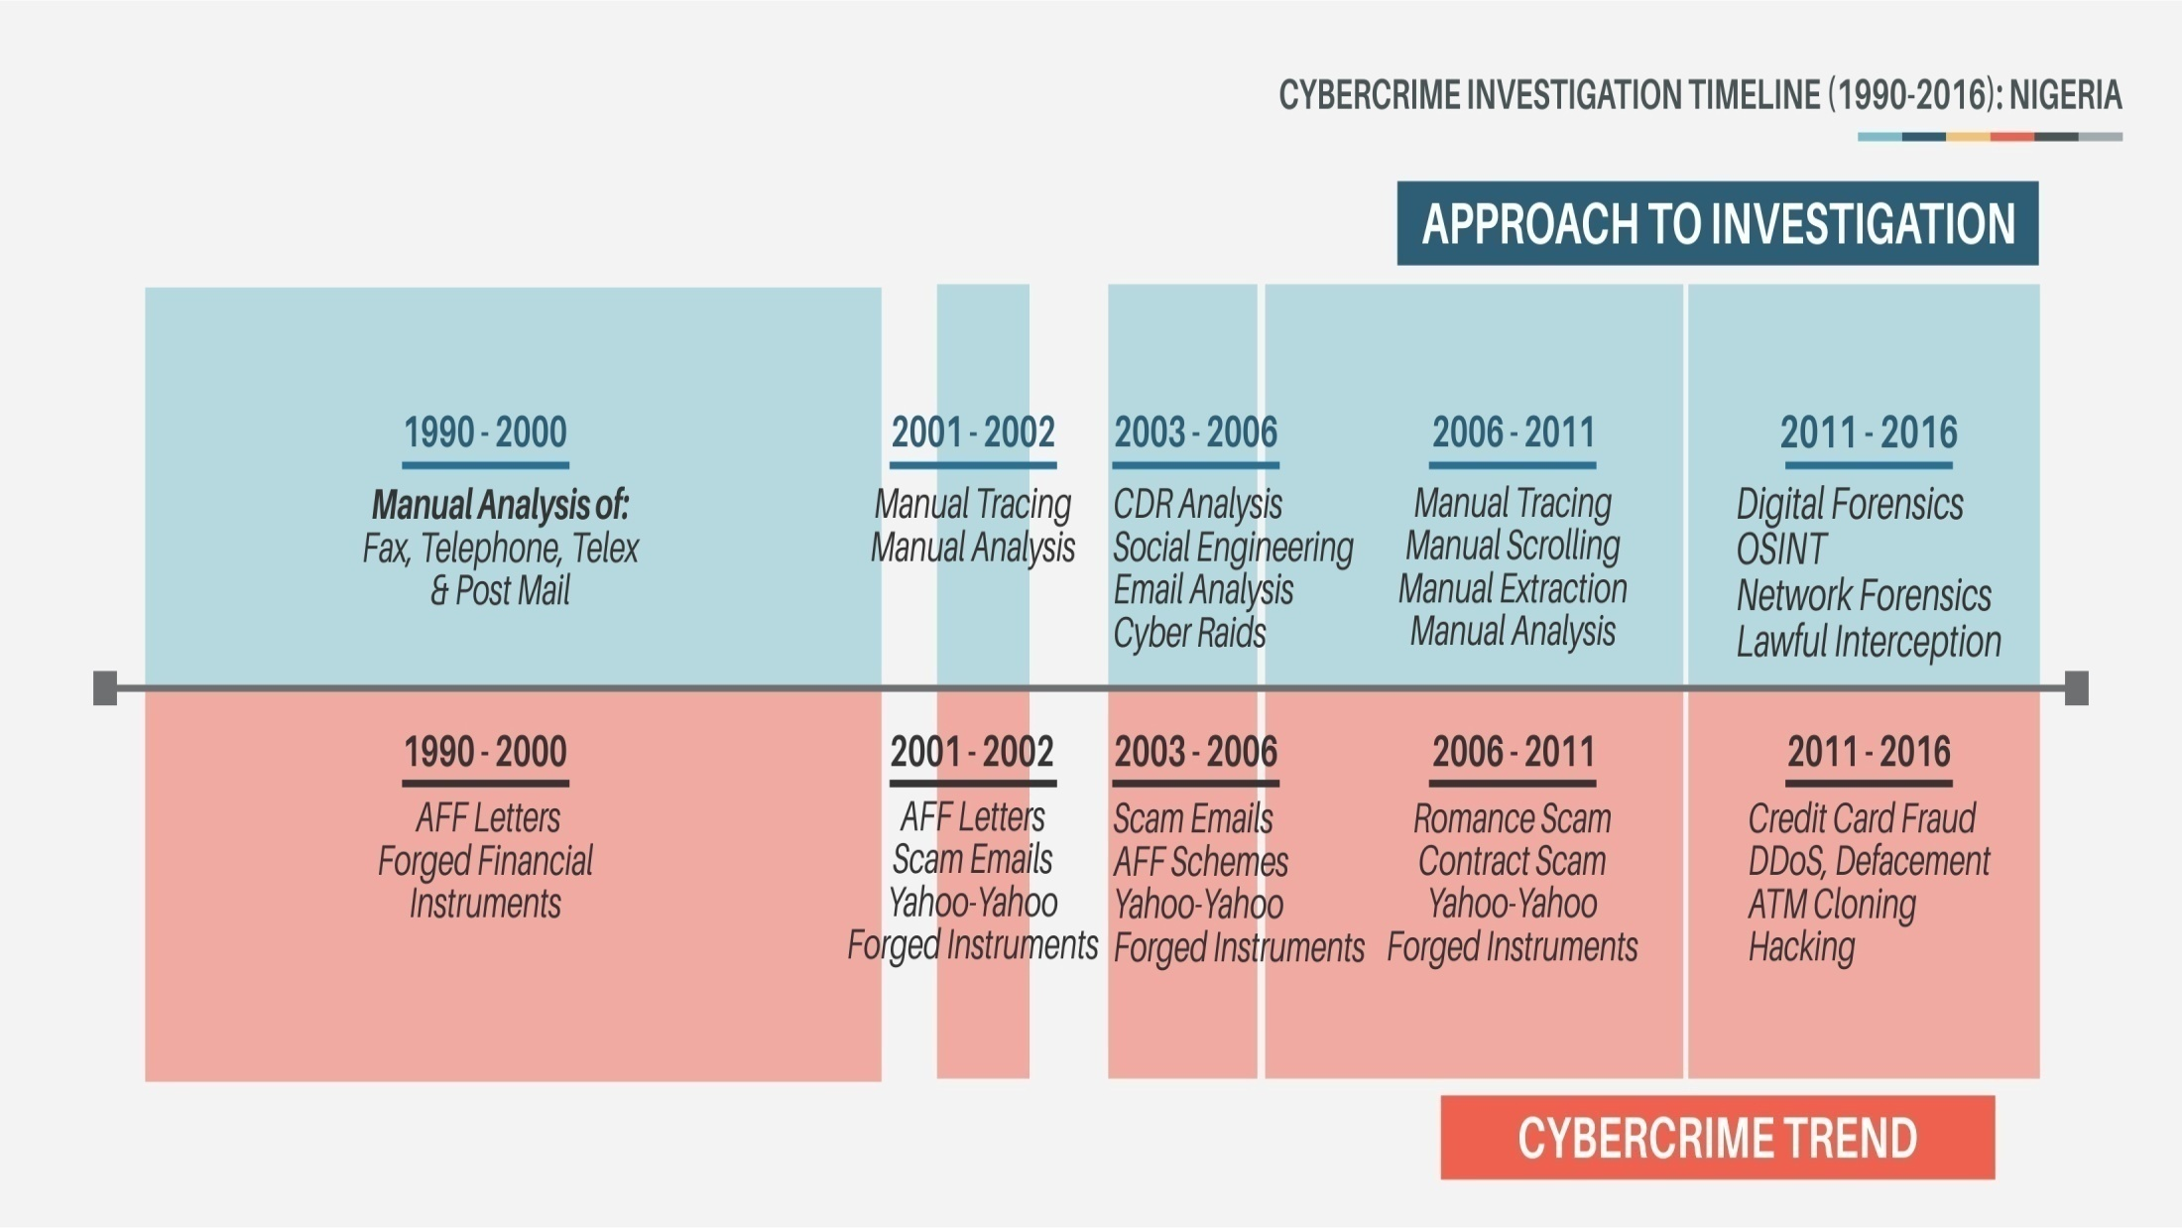

Slide 34
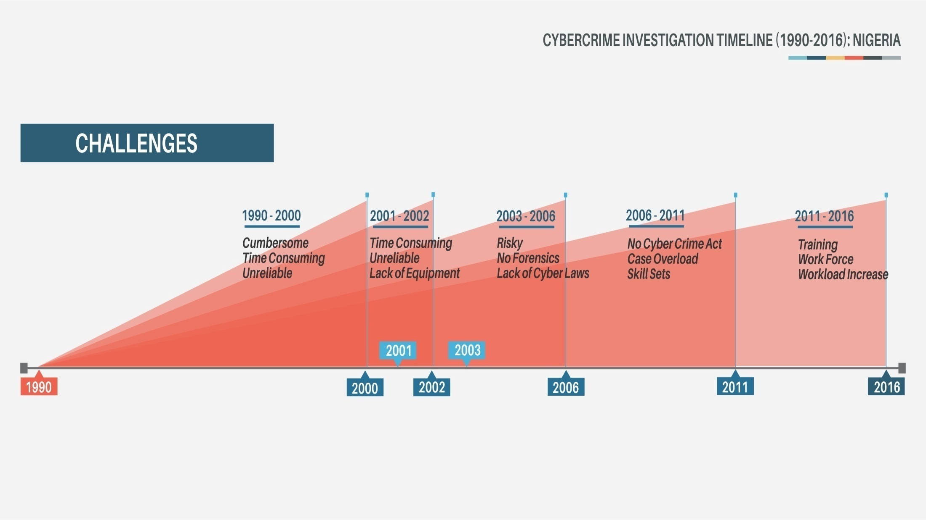

Slide 35
What Are We Doing About It?

Slide 36
DIGITAL INNOVATION
CYBER-CRIME IN AFRICA
01
Artificial Intelligence
02
Science Based Investigation
03
Blockchain Tech.
04
Evidence Based Policing & Predictive

Slide 37
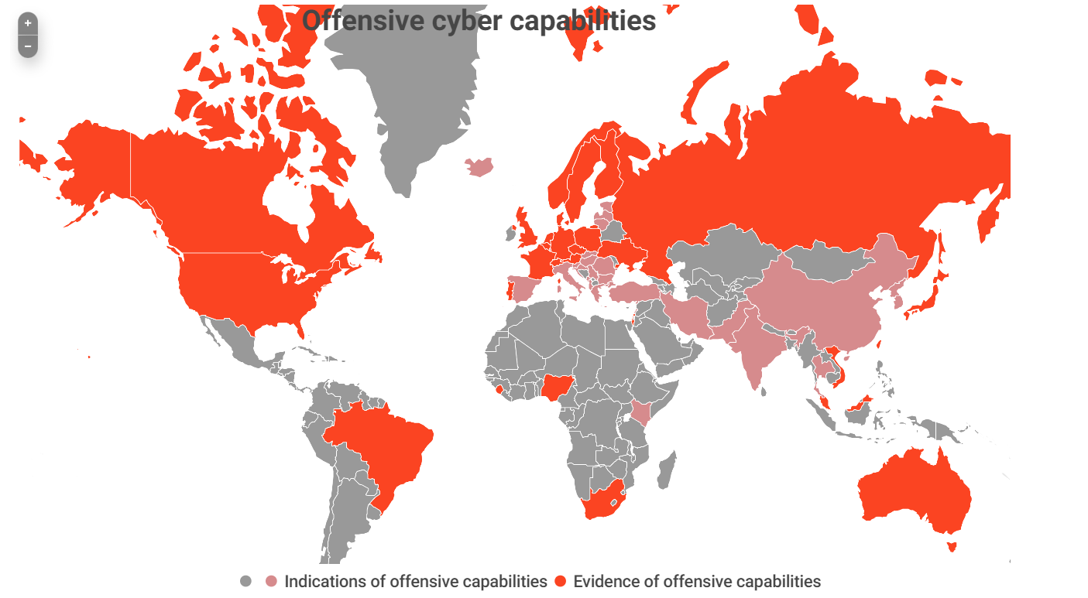
CYBER OFFENSIVE CAPABILITIES
CYBER-CRIME IN AFRICA

Slide 38
National Cyber-Security Policy 2021
CYBER-CRIME IN AFRICA
1
CYBERCRIME
2
CYBER-ESPIONAGE
National
Cybersecurity
Policy 2021
3
CYBER CONFLICT
4
CYBER-TERRORISM
5
PROTECTION OF CRITICAL NATIONAL INFRASTRUCTURE
6
CHILD ONLINE EXPOLITATION

Slide 39
WEB 3.0
CYBER-CRIME IN AFRICA
DECENTRALIZATION
SELF-GOVERING
Decentralization
Control & Personal Identity to Users
INTEROPERABILITY
SECURE NETWORK
Convergence of
Platforms .
Make a big impact with professional slides.
PERMISSIONLESS
UX & UI
Does not require authorization
Blockchain Technology

Slide 40
FUTURISTIC CRIMES
CYBER-CRIME IN AFRICA
CYBER-ENABLED CRIME.
CYBER-RAPE?
AI CRIMES, ROBOT CRIMES,
“TERRORISM”, DRONE OFFENSES
“INDUSTRIAL GENOCIDE”?

Slide 41
FUTURISTIC POLICING
CYBER-CRIME IN AFRICA
PREVENTION
PREDICTIVE & EVIDENCE BASED
SCIENCE BASED & INTELLIGENCE DRIVEN

Slide 42
BENEFITS OF ACCREDITATION
1
REFERENCE POINT
    Timely, Reliable and Proactive Intelligence to LEAs
2
ACCEPTABILITY
Global Acceptability of Evidence
BENEFITS OF ISO
ACCREDITATION
3
RELIABILITY
Strategies are set
4
    Reduced Cost on Justice Delivery
    Reduced Cost in Criminal Investigation
COST REDUCTION
5
ENHANCED
INVESTIGATION
    Centralized Criminal Database
    Scientific Driven Investigation
    Intelligence Driven Investigation
    Improved Prosecution of Criminal Cases

Slide 43
IMPLICATION OF NON-IMPLEMENTATION OF STANDARD
NON ADMISSIBILITY OF EVIDENCE
LOSS OF REPUTATION
Non admissibility of Evidence due to Non-Conformance with ISO Standard.
Loss of Reputation with National, Regional and Global Partners
APPEALS
UNAUTHORIZED ACCESS
Previous and Current Cases would be appealed based on non-validation of our processes in accordance to ISO 17025:2017
.
Evidence could be stolen or compromised with lack of Access Control Policy
INCOMPETENT ANALYSTS
LACK OF PARTNERSHIP & AFFILIATION
Lack of Trained and Competent Analysts affect the analysis of evidence
International Organizations and Labs would not affiliate with a Lab that is not accredited

Slide 44
LAWS , POLICIES & INITIATIVES
CYBER-CRIME IN AFRICA
TERRORISM
(Prevention & Prohibition) Act 2022
PROCEEDS OF CRIME
(Recovery & Management) Act 2022
01
06
02
MONEY LAUNDERING
(Prevention & Prohibition) Act 2022
NATIONAL DIGITAL ECONOMY
POLICY & STRATEGY
(2020 – 2030)
05
03
NATIONAL CYBER-SECURITY POLICY
& STRATEGY 2021
04
NATIONAL SECURITY STRATEGY

Slide 45
WAY FORWARD
CYBER-CRIME IN AFRICA
PEOPLE
PLATFORM
PROCESSES
A
Stakeholders in the
Criminal Justice System
B
Technological Solutions
C
Law, SOP and Policies

Slide 46
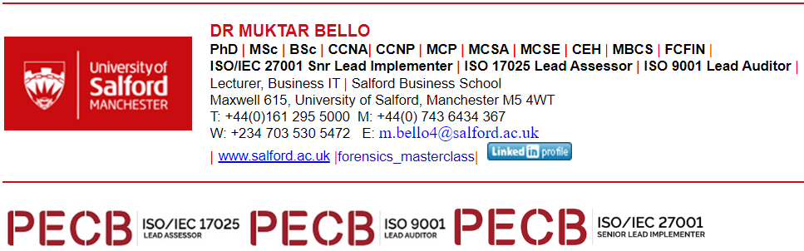
THANK YOU
CYBER-CRIME IN AFRICA

